Slide 1
Getting involved in research - a workshop for practitioners
Dr Emma Carduff, Head of Research and Innovation, Marie Curie
Sarah Stanley, Research Nurse, Marie Curie Hospice Liverpool
Kasia Patynowska, Research Nurse, Marie Curie Hospice, Belfast
Rachel Perry, Research Nurse, Marie Curie Hospice, West Midlands
Kate Maitland, Research Implementation Lead, Marie Curie
Notes:
Welcome to this 2023 Marie Curie Research Conference spotlight session, Getting involved with palliative care research, a workshop for practitioners
I would like to extend a huge welcome to you all and thank you for joining us. My names is Emma Carduff, I am Head of research and Innovation at Marie Curie.
The format of this session is slightly different from other this week so just start with a of housekeeping In order to make this a pleasant and informative workshop for all, we kindly ask you respect the following guidelines:
Many thanks to those of you who have already submitted questions for this session. Please use the 'raise hand' or chat function should you have a question or comment.
Stay on mute unless addressed by a facilitator.
If you prefer to remain anonymous, keep your video off.
Use the chat for any technical questions - our tech team will be jumping between break-out rooms to help out.
Just a reminder that This workshop is not being recorded.

Slide 2
Outline
Research Engagement
Sarah Stanley
In order for research to take place in hospices and other palliative care settings it is important to consider how we can promote research engagement with healthcare professionals, patients and caregivers. In a journal club style, this session looks to break down barriers to research engagement, and consider ways to promote a research culture
Overview
Participant voice
Break out rooms
Take home messages
Getting started with research
Kasia Patynowska
Research is beneficial to patients, families, the public and to health and social care practitioners. Yet, many barriers exist for practitioners who would like to get more involved in the research. Some of them relate to confidence, competence, resources and the proximity to a supportive, research-enabling environment. In this session we will look at how to overcome some of the barriers.
Notes:
We are absolutely delighted to be here today to share with you some of our experiences from our years of being involved in research at Marie Curie. Our plan for the session is as follows, I will be providing a bit of background. We will then split in to break out rooms. One will be led by Sarah Stanley, Research Nurse in Liverpool who will be to consider how we can promote research engagement with healthcare professionals, patients and caregivers. In a journal club style, this session looks to break down barriers to research engagement, and consider ways to promote a research culture. The other breakout is led by Kasia Patynowska, Research Nurse in from Belfast who will be talking about how to overcome the barriers the exist for practitioners who would like to get more involved in the research. Some of them relate to confidence, competence, resources and the proximity to a supportive, research-enabling environment
Housekeeping
Mute yourself
A large number of people have registered for this session today and we are keen to make it as interactive as possible using Slido, an online polling device so, it would be great if you could have (ideally) mobile phones handy in order to scan QR codes. Thanks to those of you who submitted questions in advance of the session. If you have specific questions, please put them in the chat as we would like to tailor the sessions to your needs as much as possible. Unlike our other sessions this week, Could I also please ask you to keep yourself muted.
Chat or Q&A

Slide 3

Why should you or organisation get started in research?
​ | “For me it was about being able to share my thoughts and experiences with someone who was interested in what had happened to me…​Being face to face rather than on the phone or computer was important to me as I could see… and I could see that she was truly interested and was really listening. She had taken the time and I wasn’t rushed. ​​ When I got home my daughter asked what I had got from it and I could say quite honestly that I felt better, I had got things off my chest that I hadn’t been able to say before. I knew that I was going to make a difference to other men out there”​ | ​
​ | ​
Patients and families want the opportunity to participate!
​ | “I took part in the research as I want to make a difference and help others who are grieving or who have been bereaved and sharing what we do at the Men’s Shed will hopefully do that”
​ | ​
Notes:
I would like to kick off by considering Why research is important? Why should you as a practitioner or your organisation get started in research – if you have been able to tune in to any of the other sessions in this week’s conference I hope that some of this is clear. But Firstly, most importantly, the trump card, patients and families for the most part want to be given the opportunity to participate in research – there are lots of motivations for this - they see it as important, they want to give something back, they want to make a difference, they want to improve something for the future, even if it doesn’t improve it for them, participation might even be therapeutic for some – for example, it might mean more interactions with healthcare staff or an opportunity to share their story. Furthermore, Patients involved in research also tend to do better and live longer. With all this in mind, perhpas we need to ask ourselves, is it ethical to not offer our patients research opportunities? Are we denying patients and families access to new drugs, interventions – if we were to ask ourselves this question with oncology in mind, I’m confident I know what the answer would be. With person-centredness is at the heart of our research activity, We have found that sharing these patient stories and feedback is the most powerful tool to get people on board with research, as it really helps to breaks down barriers. With this in mind, I would like to share a few quotes from participants who were involved with research to understand The Role of the Men’s Shed in a Hospice day service context which was led by Rachel Perry, Research Nurse in the West Midlands and funded through a Marie Curie small grant.
“For me it was about being able to share my thoughts and experiences with someone who was interested in what had happened to me…​Being face to face rather than on the phone or computer was important to me as I could see… and I could see that she was was truly interested and was really listening. She had taken the time and I wasn’t rushed. ​​
When I got home my daughter asked what I had got from it and I could say quite honestly that I felt better, I had got things off my chest that I hadn’t been able to say before. I knew that I was going to make a difference to other men out there​”
“I took part in the research as I want to make a difference and help others who are grieving or who have been bereaved and sharing what we do at the Men’s Shed will hopefully do that.”

Slide 4
Why should you or organisation get started in research?
Understand the population you serve
Identify important questions – often can only be answered through research
Produce up to date, targeted evidence to deliver the best care
Produce the evidence to implement change to drive improvements
It can bring in money
Personal and professional development
Notes:
But there are many more reasons :
Research can help you understand the population you serve so you can tailor the care you give accordingly.
You may have a question that is important to answer – and this can only can be answered through research – let’s turn to the ReCOVERY trial for a moment which, during the pandemic, was a great example of an important question, a simple design, that everyone could be involved in answering. – shows us how everyone can be involved in a change, you don’t need to be a principle investigator!
We need more, up to date, targeted evidence to deliver the best end of life care for everyone – with consideration of people from different ethnic backgrounds, genders, geographical areas, with different conditions, support networks, the list goes on
Research helps us understand what works and what doesn’t. Under what conditions?
To implement changes that will drive improvements in end of life care and support
And it’s the research that will Provide us with the vital evidence to help bring about that change
Being involved in research can (sometimes) bring in money and resource, depending on the study and the setting
Finally, research can be Changing, challenging, evolving, rewarding and All of this contributes to you own professional development/that or you or your staff
What I hope becomes clear today, there is a spectrum of ways that people can be involved with research – Some people will be galvanized by curiosity, others a desire to think critically about their practice. Sometimes you might get involved because it’s opportunistic for example, you’re invited to recruit patients, families or staff for a research project. And for others, there will be a desire to be doing research yourself, starting with a question and having a desire to generate new knowledge to answer that question, whether through a review of the literature, perhaps a small piece of research at your place of work or even through post-graduate study. Our 2 breakout sessions are designed to reflect this spectrum.

Slide 5
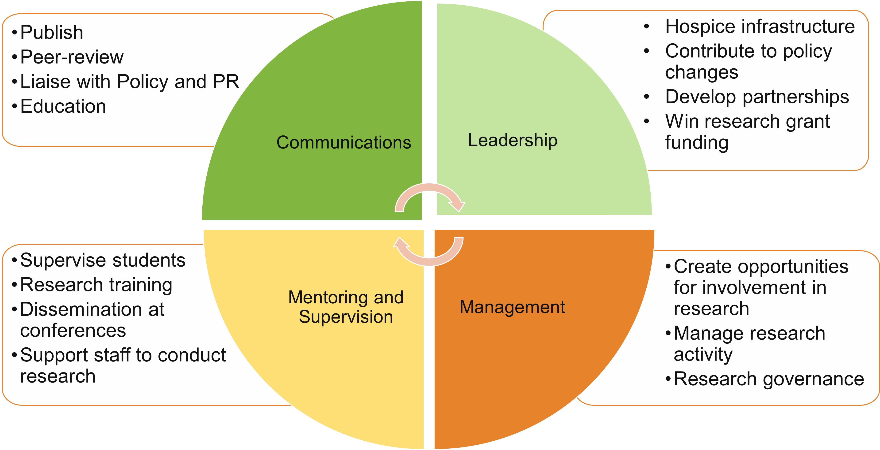
Place-based Research at Marie Curie
Notes:
Research is a long-established function at Marie Curie, in fact research has been at our core since 1952 when a seminal report on the state of dying at home was published in partnership with the Queen’s Nursing Institute. Nationally we fund research, internally through our small grants scheme and impact fund and externally through our competitive funding streams. We also fund 2 research centres in Cardiff and at University College, London. In short, we want to ensure that our patients, families and staff are able to provide the best possible evidence-informed care and have the opportunity to participate in research. Importantly, we know that to do this, research needs to be grounded in practice. It requires proximity to the people whose experiences at EOL we want to improve. To this end, we also have a team of 5 Marie Curie Senior Researchers and 7 Research Nurses/Nurse Researchers! and who lead, engage, manage, govern and disseminate research within their Marie Curie places and hospices around the UK. This slide highlights just some of the activities our team are involved with and is by no means exhaustive. Some of our team also work clinically in a blended role, including Kate Maitland, who is here today and is our Research Utilisation and Service Innovation Lead who oversees practice change across the charity. In response to one of the questions which has already been submitted Over the years, funding for research nurse support has also been supplemented by NIHR and I would encourage anyone who has an interest in research, who lives in England, to make contact with you NIHR Clinical Research Network. This can be hugely beneficial in providing supporting infrastructure and expertise that allows research to take place. For research that meets certain criteria NIHR offer free of charge operational and practical support, including:
Advising researchers on how to make their study work effectively
Making it easier to set up a study
Helping health and social care researchers to identify suitable sites and recruit participants to take part in studies
Funding the people and facilities needed to carry out research
Access to national and locally designed research-related training
Just a reminder, she says through gritted teeth that this service is only available in England

Slide 6

Take home messages
There are lots of ways to be involved in research but start with a curiosity and a desire to change
Patients and families want to be involved in research so if you can give them the opportunity
Embedded, dedicated and passionate champions
The vision – Research is business as usual
Can you help to move research up the agenda?
Notes:
Close.
Thanks everyone for your participation in the breakout rooms. If you would If you would like to hear more about our work at Marie Curie you can sign up to our newsletter using the QR code on the slide. As we reach the end of the session Could I please invite you to consider whether you would be interested in being involved in a palliative care research practitioner network in the future. If this sounds useful, please you put a yay/nae or any ideas in the chat, including where we might advertise this to ensure we reach everyone.
A few Take home messages from today’s session:
I hope it’s clear that there are lots of ways to be involved with research. For some this may be exploring a curiosity in your practice and others may be passionate about a career as a clinical academic. A lots in between. But remember, patients and families want to be involved in research so if you can, give them the opportunity. Having staff who are research aware/active really facilitates this.
If we want to ensure that our patients and families have the best care and that are staff are well supported, the vision has to be that research is seen as BAU across all settings operating within our sector.
I would invite you to reflect on what you have heard today and to consider whether you could play a role in moving research up the agenda in your organisation? From the ward to trustees to local commissioners – we need to embed it on the organisational agenda.
That just leaves me to say a huge thank you for coming, the slides will be available for you after the conference and have a great day

