Slide 1
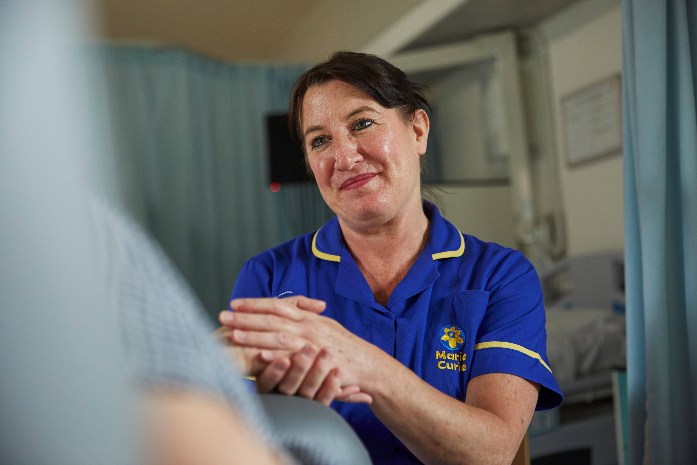
Whatever the illness, we’re with you to the end

Slide 2
USER NOTES – DELETE THIS PAGE BEFORE YOUR TALK
You don’t have to use a PowerPoint presentation.
This presentation includes videos.
You can add slides for audience questions or to explain an activity if you wish.
You can remove slides to make the talk shorter or take out information if a service isn’t provided in your area. There are also extra template pages towards the end, which can be deleted if not needed.
You can add other slides with the ’new slide’ button.
You can change the order of the presentation – remember to make these changes in the script guide template too.
You can add your own photo or image to the ‘My Marie Curie Story’ slide if you wish to.
Only include three out of the six suggestions on the ‘How you can support us’ slide.
The length of a presentation will depend on the audience and your presenting style, but a rough guide is:
  8-10 slides for a 10-minute presentation
  10-15 slides for a 20-minute presentation
Remember this is just an aid to help with your talk - it’s your words which will have the biggest impact.

Slide 3
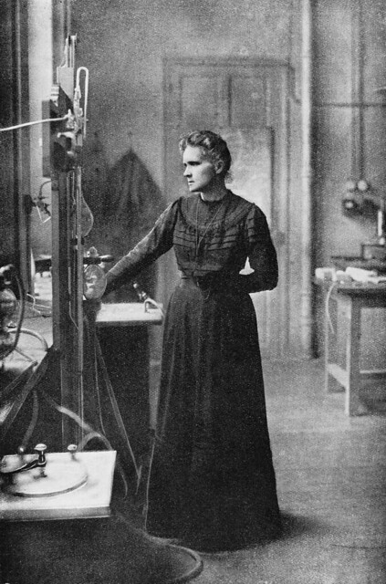
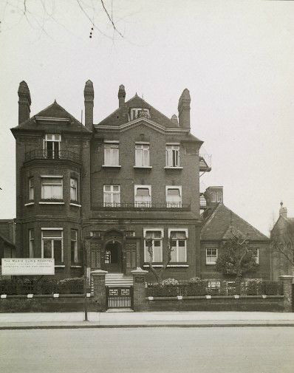

Our beginnings
Marie Curie Hospital, Hampstead
Mrs. Alice Macpherson donated her engagement ring, 1948
Marie Curie (1876-1934) Photo circa 1910

Slide 4
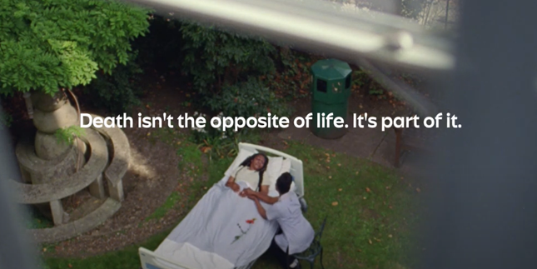
Life with a terminal illness

Slide 5
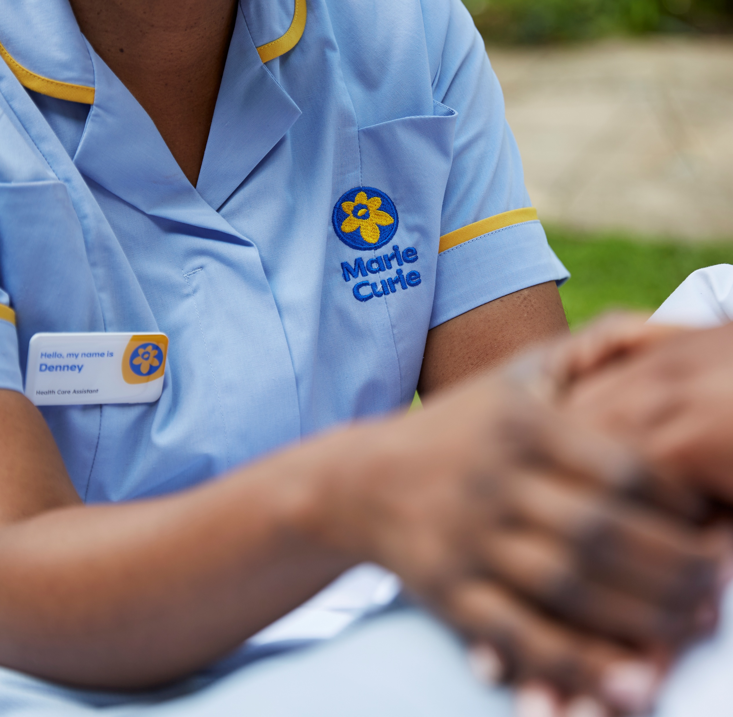
Whatever the illness, we’re with you to the end
    Someone has a terminal illness when they reach a point where their illness is likely to lead to their death.
    They may live for days, weeks, months or even years after this point.
    We care for people with any terminal illness, including Alzheimer’s (and other forms of dementia); heart, liver, kidney or lung diseases; motor neurone disease; Parkinson’s; and advanced cancer.

Slide 6

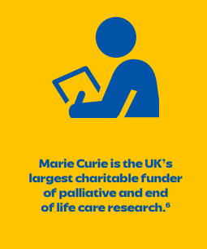
How we’re helping
    We are the UK’s leading end of life charity, providing free expert care and support for anyone living with terminal illness, through:
    Hospice Care at Home
    Marie Curie Hospices
    Marie Curie Companions
    Information and Support
Source: Marie Curie Annual Report 2023/24, published December 2024

Slide 7


Slide 8
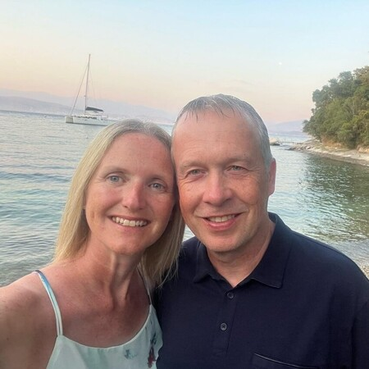
“Everyone should have the right to choose where they would prefer to die”
Jo struggled to secure nighttime care for her husband, Mat.
“Mat's wishes were for him to pass away at home and not in hospital and he was able to do this peacefully with his family and the support of an amazing Marie Curie Nurse being there for us all.”
“Every time Marie Curie turned up, I could literally just go upstairs and go to bed, which was so different to everything else I was offered.”
“Everyone should have the right to choose where they would prefer to die, with the right community support and care.”
Notes:
Jo’s story – can be used as an example of Marie Curie Hospice Care at Home & Overnight Care.
Jo struggled to secure nighttime care for her husband, Mat.
Context:
In January 2024, Mat was diagnosed with a brain tumour after having a seizure whilst driving. He had no symptoms previously, so life changed so quickly.
By June, Mat was needing more support, and Jo wasn't getting any sleep due to his seizures, pain management or supporting his care needs during the night. That’s when Marie Curie first came in, overnight.
Mat received care from the wonderful Marie Curie healthcare assistants and nurses, who would look after Mat overnight, allowing Jo to rest whilst knowing he was well cared for.
Mat passed away peacefully at home in August 2024.
Key quotes:
“Mat was so brave and so determined to live life to the fullest after his diagnosis however he was constantly going in and out of hospital due to his seizures, pain management, radiotherapy and many appointments.”
“Mat's wishes were for him to pass away at home and not in hospital and he was able to do this peacefully with his family and the support of an amazing Marie Curie Nurse being there for us all.”
“Every time Marie Curie turned up, I could literally just go upstairs and go to bed, which was so different to everything else I was offered.”
“Everyone should have the right to choose where they would prefer to die, with the right community support and care.”

Slide 9

Marie Curie Nurses
    Marie Curie Nurses, Healthcare Assistants and other healthcare professionals provide clinical care and emotional support in the comfort of your own home, day or night.
    Our nursing service provides the care you need, allowing people to stay at home for as long as possible.
    Our nurses help with managing symptoms, easing pain, protecting dignity and helping people live the best life possible.
    We also support the people close to them too – from reassurance and practical information to letting them take a break.

Slide 10
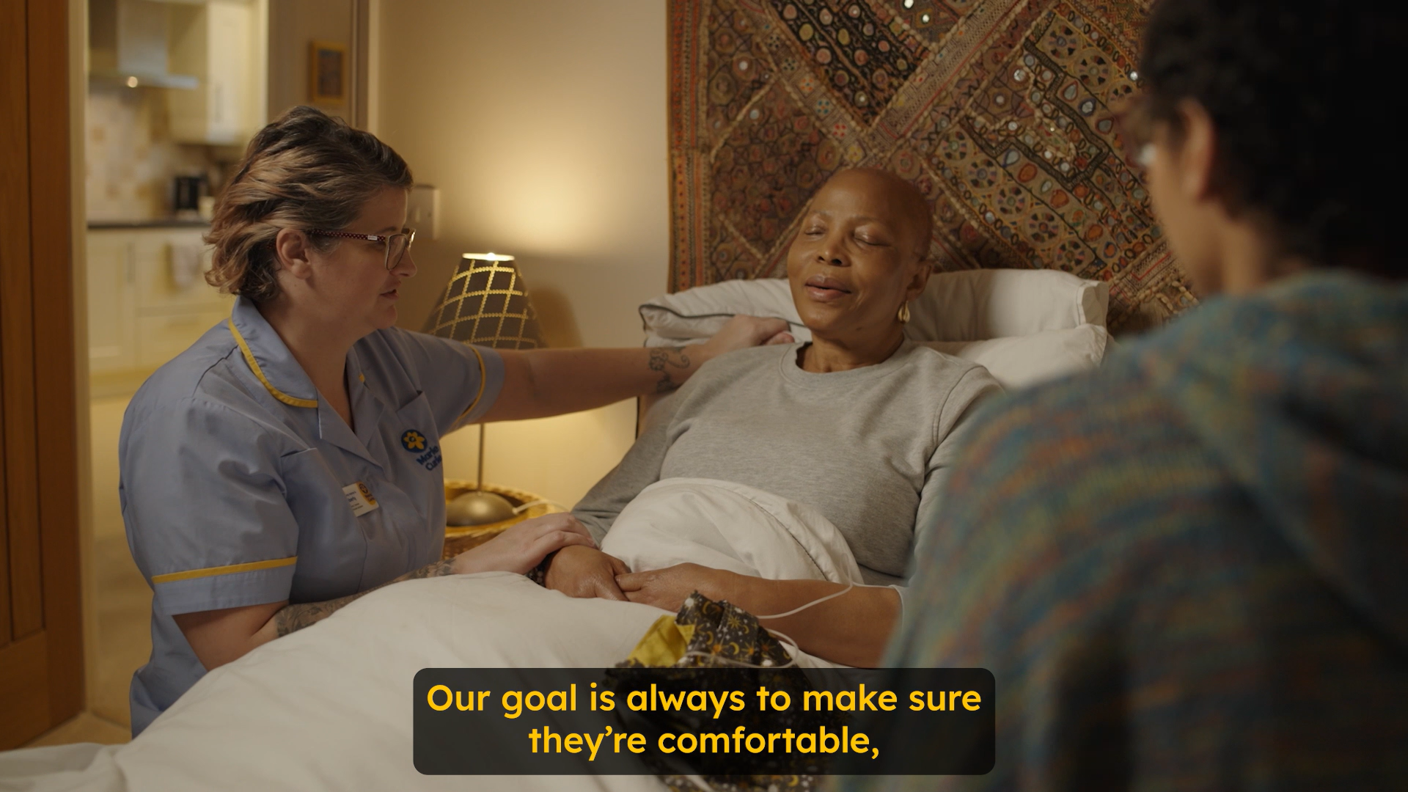
Marie Curie Nurses

Slide 11
My Marie Curie Story

Slide 12
Marie Curie Hospices
    Our hospices provide expert care and support, round-the-clock, in a welcoming and comfortable environment.
    People can stay at the hospice or just come in for the day.
    Our doctors, nurses, therapists, social workers, chaplains and counsellors work together to help people have the best possible quality of life.
    We provide expert care, and practical and emotional support, tailored to people’s individual needs, for you and those close to you.

Slide 13
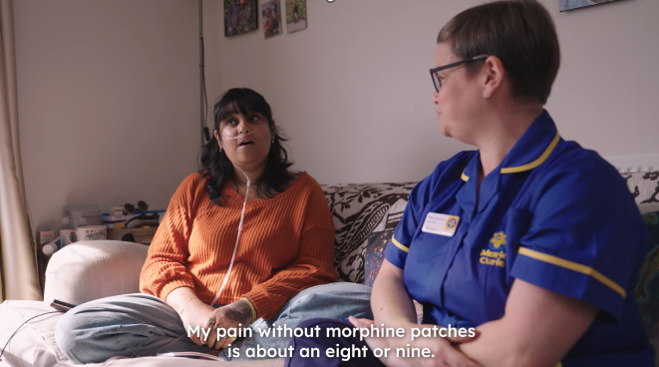
Jyoti’s story
Notes:
Jyoti is being supported at home by the West Midlands Hospice and Clinical Nurse Specialist Jenna Norris.

Slide 14
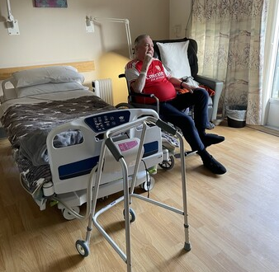
“It’s been like a home from home in the hospice.”
Pat has had Hospice Care and Hospice Care at Home.
"I’ve been absolutely amazed by the care on offer from the Marie Curie hospice, Bradford. The things they’ve put in place for me, the care I’ve had, I’m blown away by it."
"I’m going home from the hospice soon, and the Marie Curie team have helped ensure I can get around my flat once I’m there. I’ve been having physiotherapy; they come in regularly and get me walking from my bed to the door and back.“
“It’s not what I expected a hospice to be at all. I thought hospices were just places where people go to die.”
Notes:
Pat’s story – can be used as an example of Hospice Care and Hospice Care at Home.
Pat has had Hospice Care and Hospice Care at Home.
Context:
Pat is based in Yorkshire and is a big Arsenal fan.
Pat first experienced serious backache when working when he knew that something wasn’t quite right. After many years back and forth undergoing tests, he was diagnosed with prostate cancer, which had spread to his hips, up his spine and into his cranium. It was a big shock to him.
Pat received hospice care at home from Marie Curie. He also received hospice care too at Bradford hospice.
Key quotes:
"I’ve been absolutely amazed by the care on offer from the Marie Curie hospice, Bradford. The things they’ve put in place for me, the care I’ve had, I’m blown away by it.“
"I had some hospice care at home from Marie Curie, they came about five or six times and sat with me overnight while I slept. It was great to know that someone was there and could help me if anything happened to me."
"I’m going home from the hospice soon, and the Marie Curie team have helped ensure I can get around my flat once I’m there. I’ve been having physiotherapy, they come in regularly and get me walking from my bed to the door and back.“
“It’s not what I expected a hospice to be at all. I thought hospices were just places where people go to die. I’m not worried about dying.”
“I feel pretty optimistic that things are getting better, not worse, even though I’ve been told I’m dying. I’m not bothered about dying, we’re all going to die and I’m going to face that, but I just don’t want to die in agony.”

Slide 15
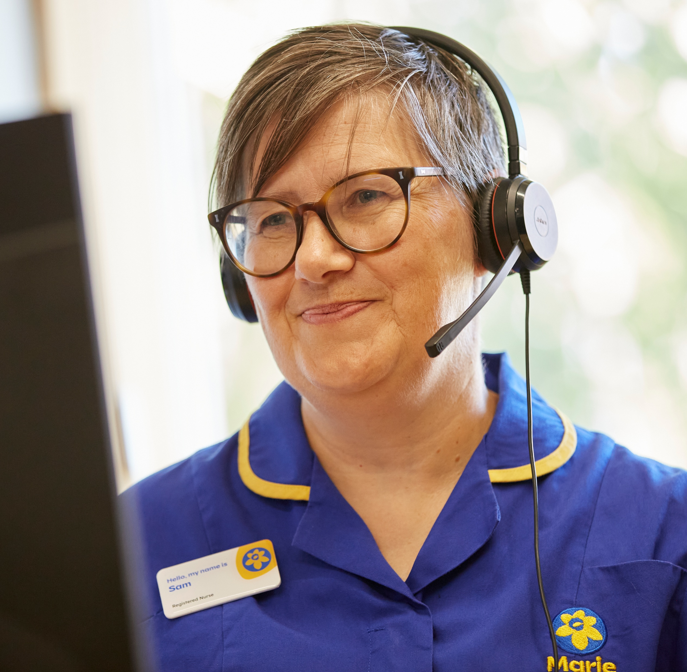
Getting support when you need it
      Marie Curie Support Line:
      0800 090 2309 or online chat
      Information: mariecurie.org.uk/support
      Marie Curie Community: community.mariecurie.org.uk

Slide 16
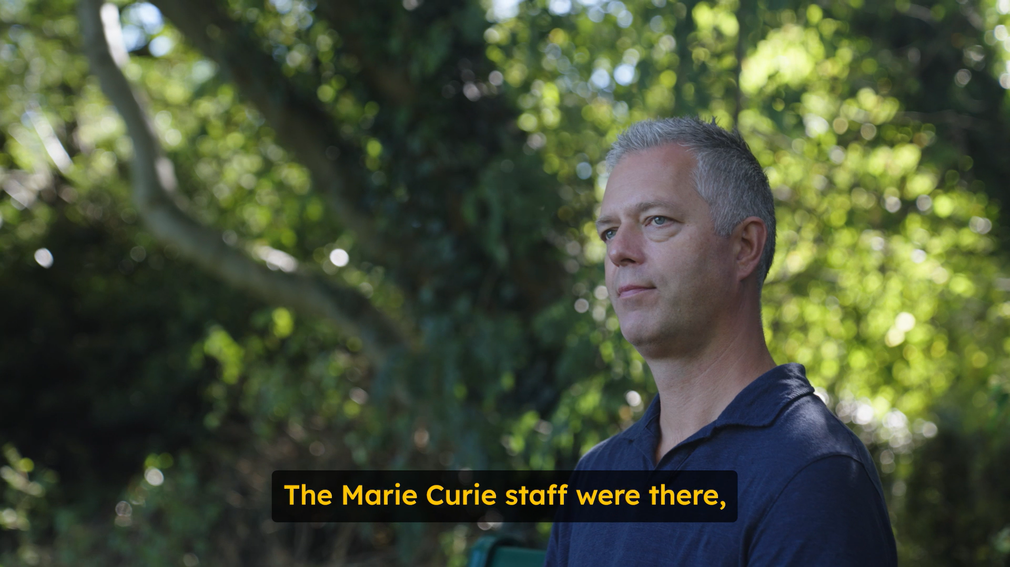
Mike’s story
Notes:
Storyteller Mike's wife Kerry was cared for at the West Midlands hospice while she was living with bowel cancer. She died in November 2023.

Slide 17
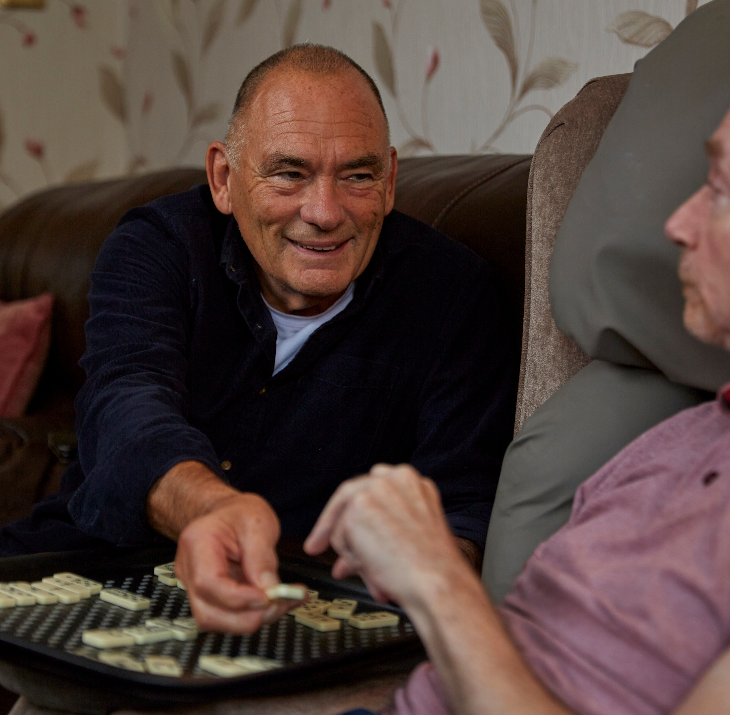
Marie Curie Companion Service
    Companion volunteers focus on what’s important to you and those close to you.
    They provide the emotional and practical support – over the phone, at home, or in hospital.
    It might be accompanying you to appointments, being there to listen to how you’re feeling without judgment or stepping in so family or carers can take a break.
Notes:
Check with your community fundraiser to see if the Companion service operates in your area.

Slide 18
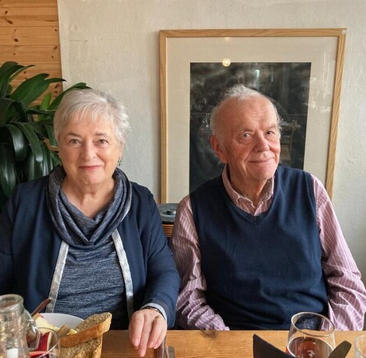
“For us to be with Dad, in his own house, all together – we feel privileged to have had that opportunity.”
Gareth spent 10 weeks in hospital before dying at home with Marie Curie support
“It was comforting to know that we were able, with the support of Marie Curie, to take him home and that he would be in his own environment, and have some dignity back”
“It made such a huge difference for us to know that right at the end, things were better for Dad and he was made to feel cared for.“
“As well as looking after Dad, they looked after us, too.”
Notes:
Mile’s family story – can be used as an example of Hospice Care at Home.
Gareth spent 10 weeks in hospital before dying at home with Marie Curie support
Context:
Gareth was diagnosed with Parkinson’s and spent 10 weeks in hospital, before his final few days at home with Marie Curie support at night.
Gareth was able to be at home, with dignity and privacy in a comforting environment with his family.
Key quotes:
“The Marie Curie HCAs were so empathetic and compassionate.”
“It was comforting to know that we were able, with the support of Marie Curie, to take him home and that he would be in his own environment, and have some dignity back”
"For us to be able to be with Dad, in his own house, and to be all together – we feel privileged to have had that opportunity, and it was because Marie Curie was available to ensure that could happen.“
“It made such a huge difference for us to know that right at the end, things were better for Dad and he was made to feel cared for.“
“As well as looking after Dad, they looked after us, too.”

Slide 19

Our work on policy and research
      Campaigning for a world where everyone gets the best experience
      possible at the end of their life, raising public awareness and influence decision-makers across the UK.
      Leading research to give the best care to people we support, and to improve our services, so that more people have the best possible experience at the end of life.

Slide 20
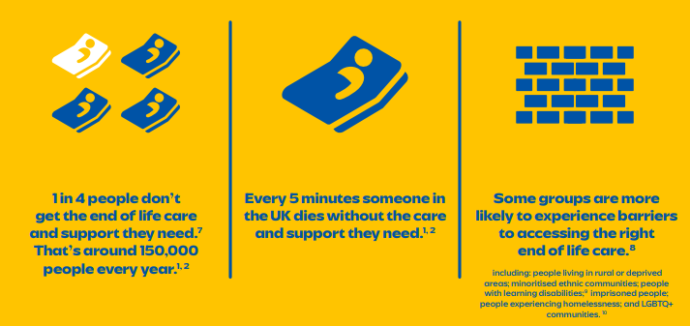
The challenges we’re facing

Slide 21
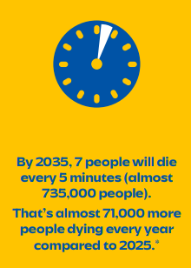

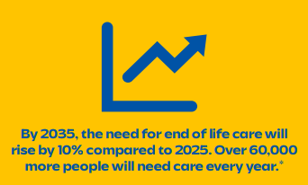
Looking to the future

Slide 22

How you can support us
    There are many ways you can help us. You could:
    Make a donation
    Take part in our fundraising events
    Organise your own fundraising activity
    Get your company, school or network involved
    Become a volunteer
    Leave a gift in your will
Notes:
Please select 3 suggested ways for your audience to get involved, or add in other suggestions which you have agreed with your community fundraiser. Do edit this page.

Slide 23
The difference your support can make
£5
can help fund heating in a hospice for an hour
£23
can help fund an hour of nursing care
£207
can help fund nine hours of overnight nursing care

Slide 24
Thank you

Slide 25
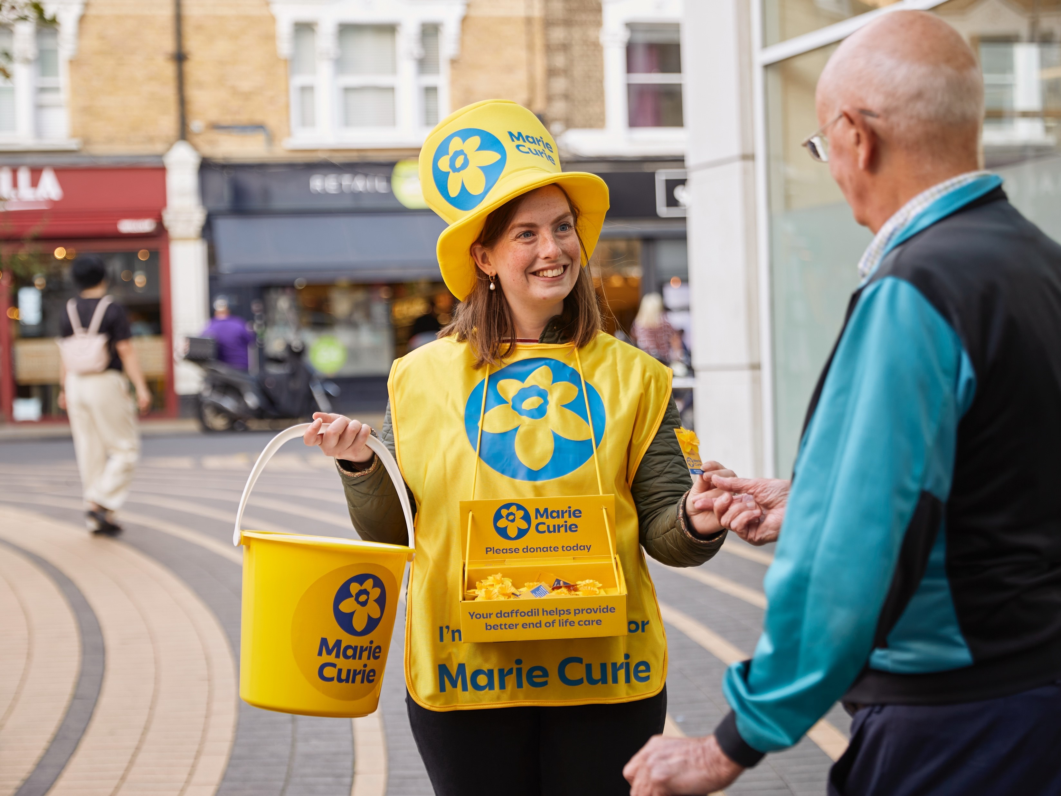
Notes:
Instructions:
Select petal border object and go to Picture Format> Send Backward> Send to Back
Select main background photo and press Delete key so the image is removed
Inside the empty content placeholder, click the “Insert Picture” icon in the centre to insert a new image
Select the newly inserted image and go to Picture Format> Send Backward> Send to Back – so that the petal border object appears over the top of the background image.

Slide 26


Quote or key message layout. Adjust the quote marks up or down according to the length of the text. The second quote mark should appear at the baseline of the quote
  Speaker name, title

Slide 27
Short punchy quote or key message and adjust the quote mark objects up or down to fit the text.
  Speaker name, title

