Slide 1
Marie Curie Campaign activities
2018-2019

Slide 2
Background
The Policy & Public Affairs, Campaigns and PR Teams at Marie Curie work closely together to improve care and support for people at the end of life across the UK. We:
Conduct policy research to evidence our campaigns and monitor the end of life care state in the UK. For instance, our reports on emergency admissions and the state of Fast Track Continuing Healthcare in England
Work with our supporters who get involved by signing petitions or contacting their local MPs (Members of Parliament)
Work with the local and national media to raise awareness of our work and campaigns across the country
Persuade governments across the UK to change and make laws and regulations which will make the experience of having a terminal illness the best it can be
As health and social care are devolved matters, we are divided into four teams, one for each nation working with Westminster, the Scottish Parliament, the National Assembly for Wales and the Northern Ireland Assembly.

Slide 3
Marie Curie Campaigns
Our recent and current campaigns:
NHS England 10 year plan
‘Scrap 6 months’ benefits campaign
Daffodil Standards

Slide 4
NHS England 10 year plan
Over five million people in England will die in the next 10 years. Every one of them deserves the very best care at the end of their lives. Yet unbelievably, we heard in 2018 that a new long term plan for the NHS in England would not prioritise end of life care
In response we launched a campaign to make sure that care for dying people would be a key part of the plan
Over 1,400 Marie Curie supporters contacted their MPs and asked them to act - we reach 8/9 out of 10 MPs with the campaign! MPs then raised the issue in parliament and in conversations with government ministers
We also raised the issue directly with the media, Ministers and the NHS to ask them to prioritise end of life care. See Jane Collins’ open letter to NHS Chief Executive Simon Stevens

Slide 5
NHS England 10 year plan
We are pleased to report that when the NHS plan was published in January 2019, it included key commitments to improve end of life care
This would not have happened without our campaign and the action taken by Marie Curie supporters

Slide 6
‘Scrap 6 months’ benefits campaign
Every day 10 people die while waiting for a decision on their benefits. Many more dying people spend months wading through red tape to get the financial support they need
Instead of enjoying life with their loved ones, dying people have to spend time filling in forms and attending interviews with benefits advisors. Some must even go to coaching sessions aimed at getting them back to work
People can only get quick and easy access to benefits if a doctor or nurse says they have less than six months to live. Yet many have unpredictable illnesses and so are facing a mountain of red tape instead

Slide 7
‘Scrap 6 months’ benefits campaign
Marie Curie is working with the Motor Neurone Disease (MND) Association to call for a change to the law. The change would remove the six-month rule and give everyone facing terminal illness fast access to the benefits they need
In Scotland, we have successfully campaigned to change legislation so that doctors will soon be able to use their clinical judgment (alongside Government-issued guidance) to determine who should be considered terminally ill

Slide 8
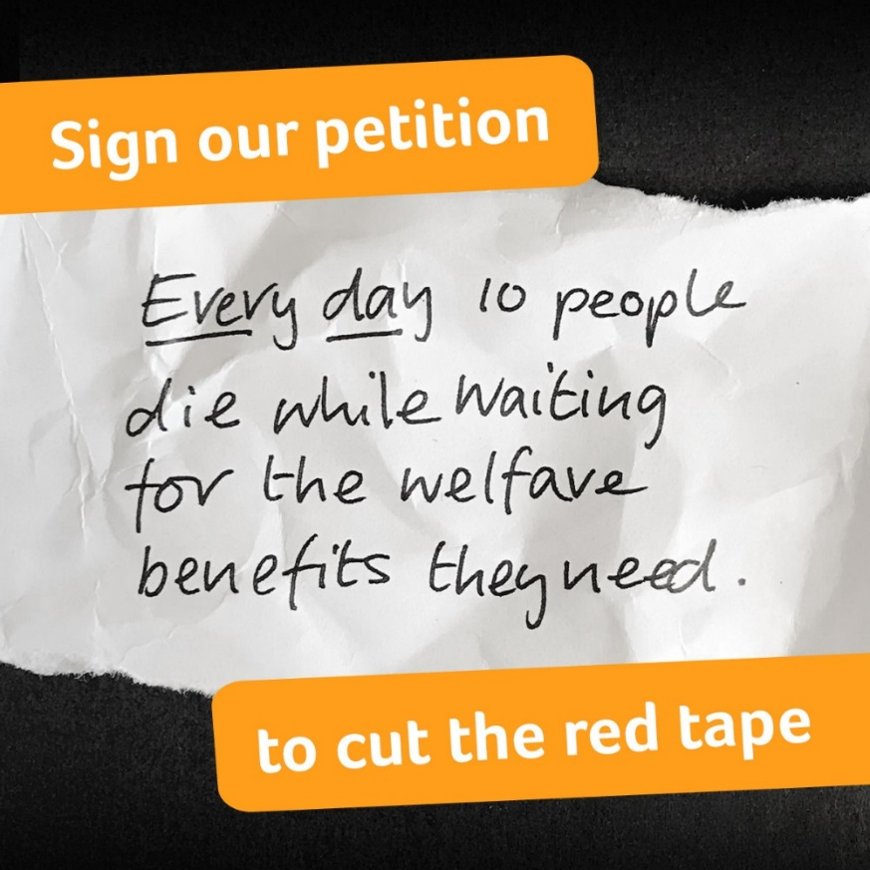
‘Scrap 6 months’ benefits campaign
At the beginning of 2019, we launched a petition to ask people to support our campaign to remove the 6 months’ time limit

Slide 9
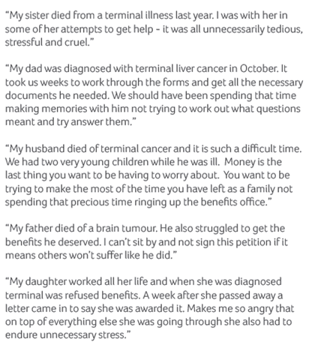
‘Scrap 6 months’ benefits campaign
Here are a few comments we received through the petition

Slide 10
‘Scrap 6 months’ benefits campaign
“I felt so angry when I was assessed as not fitting the criteria, it’s very disheartening and I just don’t understand why it has to be so difficult.”
“I’m hoping that in the future, things are made much easier for people and they can spend time with the people they love most, instead of fighting against an unfair system.”
Lorraine, who is living with motor neurone disease but was denied benefits. You can read her full story here.

Slide 11
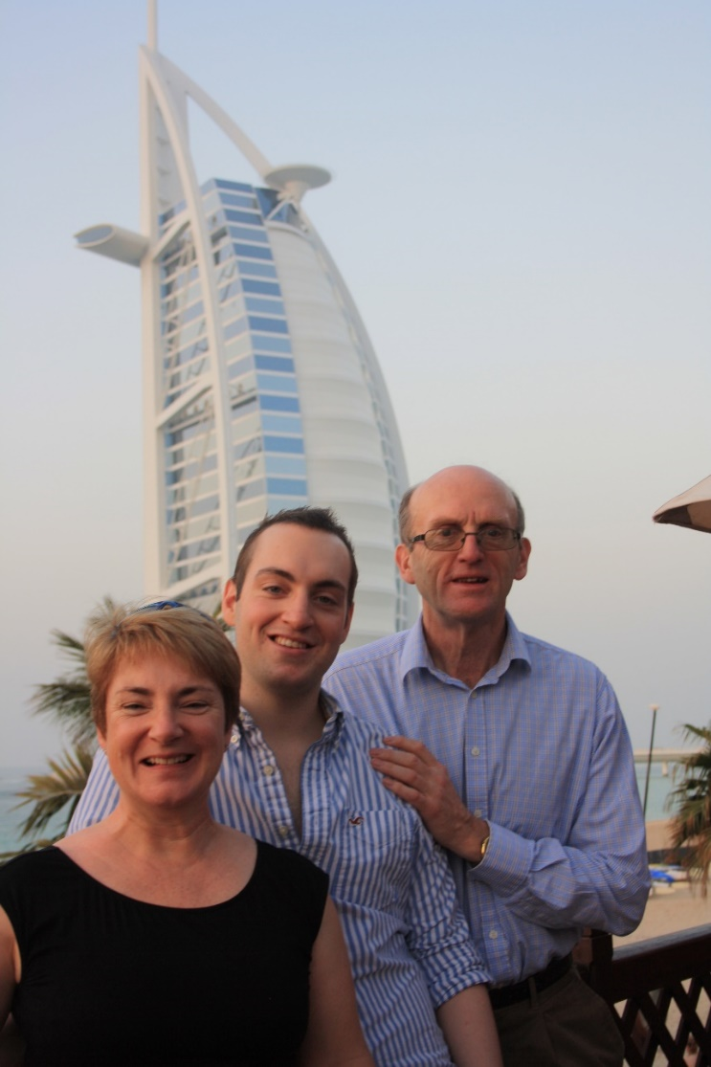
‘Scrap 6 months’ benefits campaign
“During the last two and a half years of his life Rob had had to endure a living nightmare. For anyone, the trauma of a life-threatening illness would be bad enough without being compounded by financial disaster and astonishing insensitivities.”
“To have to suffer the symptoms of leukaemia is more than enough for a 21-year old to endure, without this total loss of financial independence.”
Philip George, who’s son Rob struggled to get benefits before he died. Full story here.

Slide 12
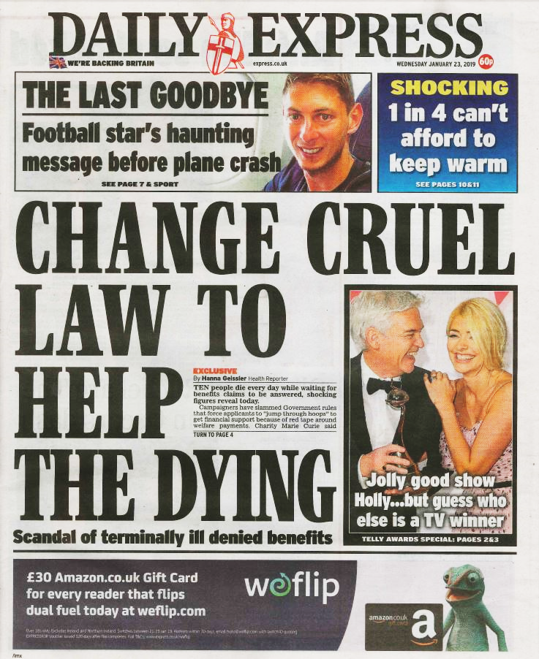
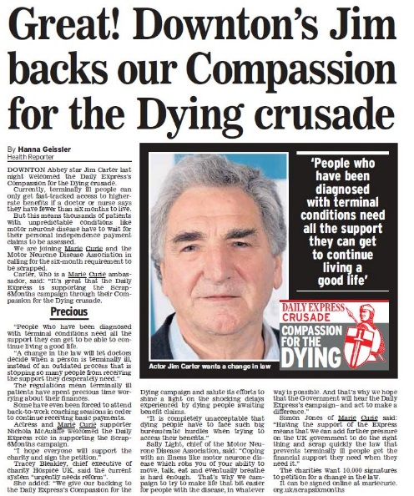
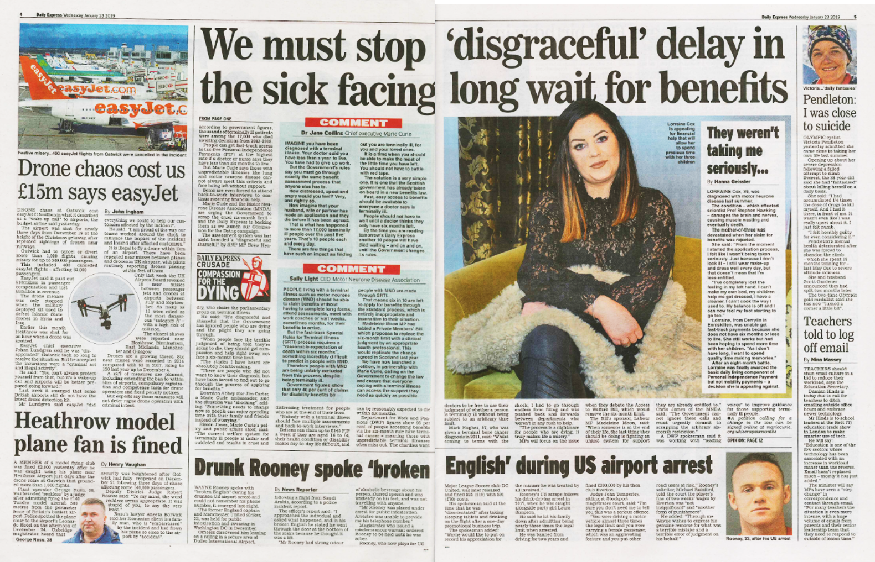
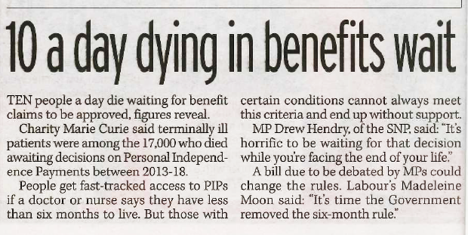
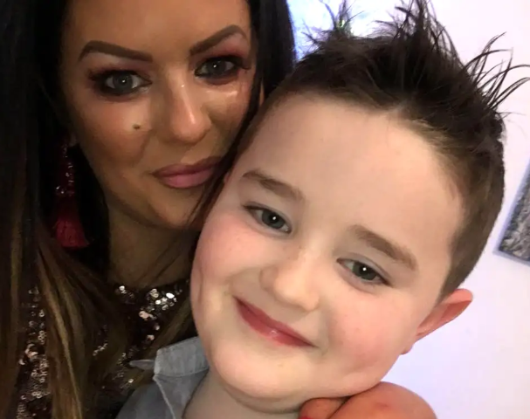
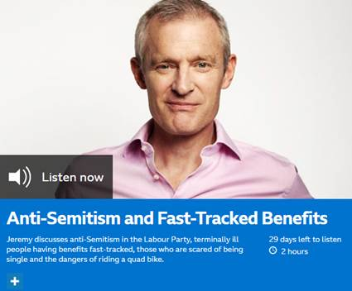
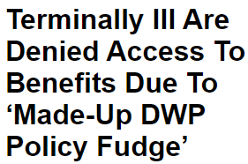
‘Scrap 6 months’ benefits campaign
Notes:
The campaign received incredible support in the media. We secured front page of the Daily Express twice, multiple double page & single page spreads, as well coverage on the BBC, ITV, Channel 5, Sky, BBC Radio 2, 4 & 5 Live, as well as in the Mirror, Sun, I, Mail Online, the i., Press Association, regional newspapers and regional broadcast. Also significant print and broadcast coverage in NI.

Slide 13
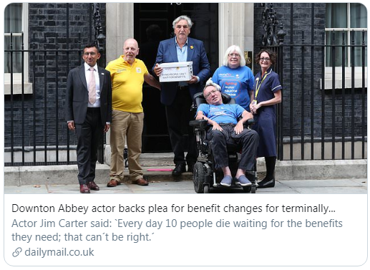
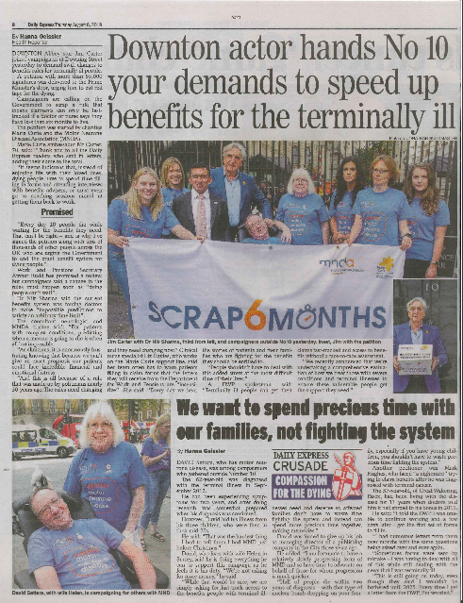
‘Scrap 6 months’ benefits campaign
On 7 August 2019, Marie Curie and the MND Association supporters along with actor Jim Carter handed in the petition to the new Prime Minister at Downing Street to ask him to remove the 6 months rule
Thanks to our supporters, the petition was a success: 55,435 people signed it!
Notes:
We secured TV, radio, print and online coverage for the petition hand-in

Slide 14
‘Scrap 6 months’ benefits campaign
In parliament
At Westminster, we are supporting a Private Member’s Bill (a piece of legislation proposed by an individual MP) tabled by the Labour MP Madeleine Moon, which would translate the Scottish legislation to Westminster and remove the six months left to live criteria
The Bill fell down at this parliamentary session but we will seek to bring the Bill back in the next session. We are using the legislation to focus support and through this engage the Government
In total, more than 130 MPs from all parties support our campaign

Slide 15
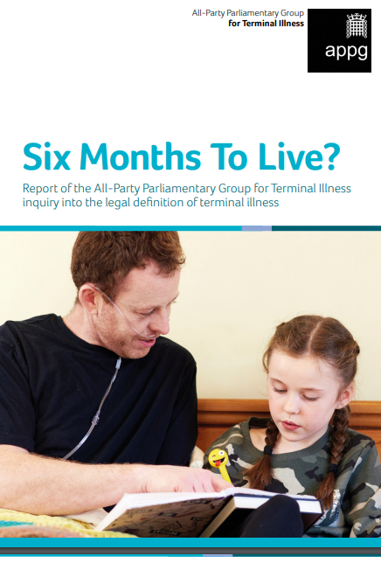
‘Scrap 6 months’ benefits campaign
In parliament
Marie Curie provides the Secretariat to the All-Party Parliamentary Group for Terminal Illness (APPGTI)
In February 2019 we launched an inquiry into the legal definition of terminal illness
We received numerous responses from professional bodies, charities, political parties and healthcare professionals
On 3 July 2019 we launched the APPGTI report in parliament with an afternoon tea organised alongside the MND Association for the #scrap6months campaign
The report recommends the removal of the 6 months’ time limit and to base decisions on clinical judgement only
More than 60 MPs and Peers attended the event and confirmed their support for the change of the legal definition of terminal illness

Slide 16
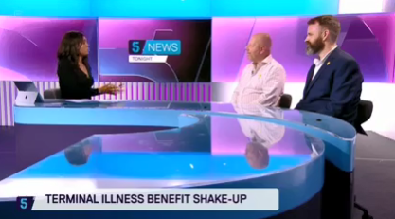
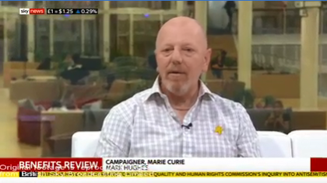
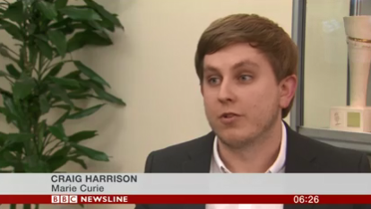
‘Scrap 6 months’ benefits campaign
On 11 July 2019, after sustained pressure, the UK Government announced a review of how well the benefits system works for people with a terminal illness
Marie Curie welcomes this review. This announcement is a successful first step in the campaign
However, we ask that the review is focussed, quick and involves people with experience and relevant charities

Slide 17
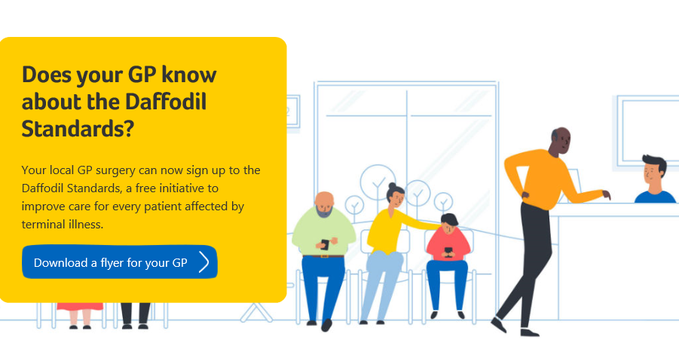
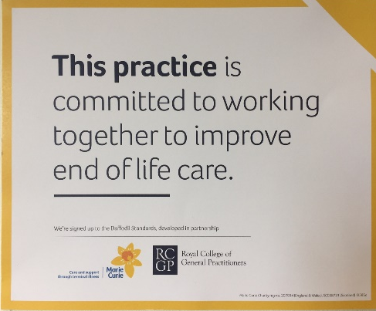
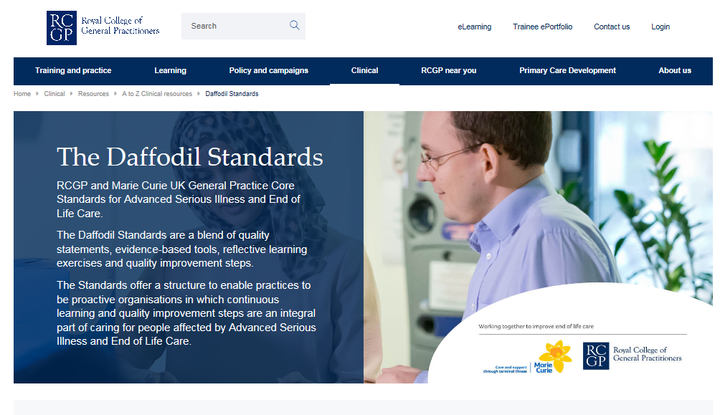
The Daffodil Standards
GPs play a key role in caring for people with a terminal illness and their family carers. But providing that care at a consistently high level of quality can be challenging
Designed by the Royal College of GPs and Marie Curie, the Daffodil Standards support GP surgeries to provide better care to everyone living with a terminal illness, their families and carers
The Standards are a free, easily accessible online resource, available to all GP practices in the UK
Hundreds of GP practices have signed up since the launch in February 2019
Every practice can display the Daffodil Mark to highlight their commitment to improving end of life care
Notes:
Hundreds of practices have already signed up but there are still thousands more to reach – you can help us spread the word by telling your GP practice about the standards.

Slide 18
Meet your MP
The Policy and Public Affairs (PPA) Team is always keen to meet MPs in their constituencies (England) to promote Marie Curie’s work and gain support in parliament
If you would like to meet your MP in his/her constituency to speak about your volunteering activities for Marie Curie and help us promote our work in parliament and the campaigns we are running, please get in touch with Marine at marine.paclet@mariecurie.org.uk
You will just have to come to the meeting, the PPA team will contact your MP and organise the meeting

Slide 19
Contacts
To find out more about our latest campaigns email campaigns@mariecurie.org.uk or visit www.mariecurie.org.uk/campaigns
If you have any questions, please get in touch:
Simon Tiller, Campaigns Manager: simon.tiller@mariecurie.org.uk
Marine Paclet, Public Affairs Officer: marine.paclet@mariecurie.org.uk

