Slide 1
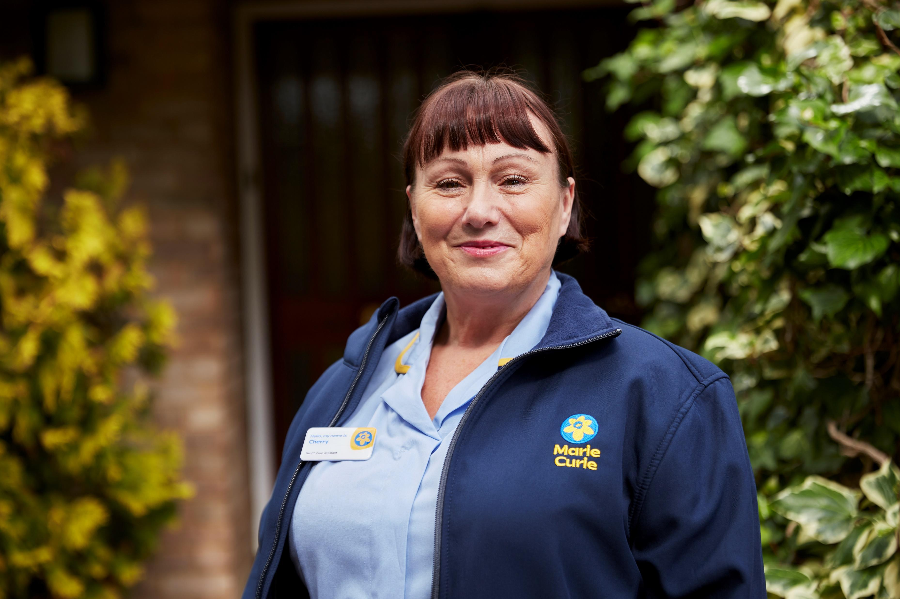
Whatever the illness, we’re with you to the end

Slide 2
USER NOTES – DELETE THIS PAGE BEFORE YOUR TALK
You don’t have to use a PowerPoint presentation
You can remove pages to make the talk shorter, or take out information if a service isn’t provided in your area.
You can change the order of the presentation – remember to make these changes in the script guide template too.
You can add your own photo or image to the ‘My Marie Curie Story’ slide if you wish to.
Only include three out of the six suggestions on the ‘How you can support us’ slide.
This presentation doesn’t include video.
You can add slides for audience questions or to explain an activity if you wish.
The length of a presentation will depend on the audience and your presenting style, but a rough guide is:
    8-10 slides for a 10 minute presentation
    10-15 slides for a 20 minute presentation
Remember this is just an aid to help with your talk, it’s your words which will have the biggest impact.

Slide 3
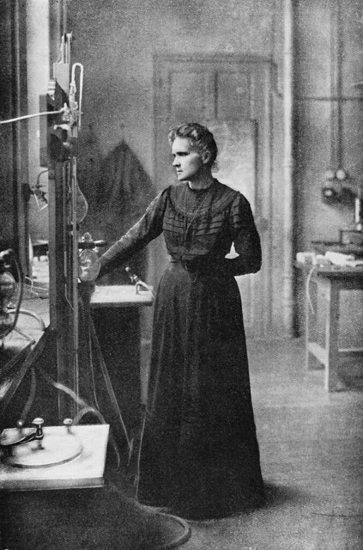
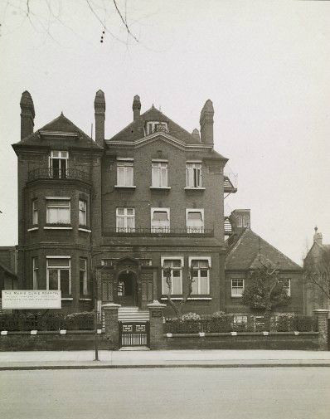
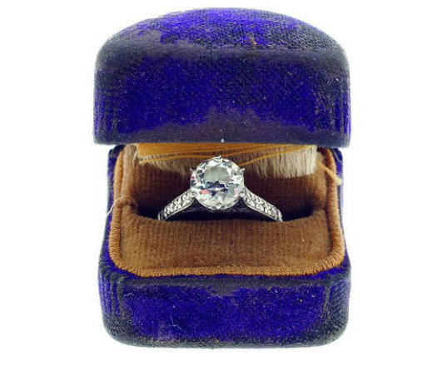
Our beginnings
Marie Curie Hospital, Hampstead
Mrs. Alice Macpherson donated her engagement ring, 1948
Marie Curie (1876- 1934) Photo circa 1910

Slide 4
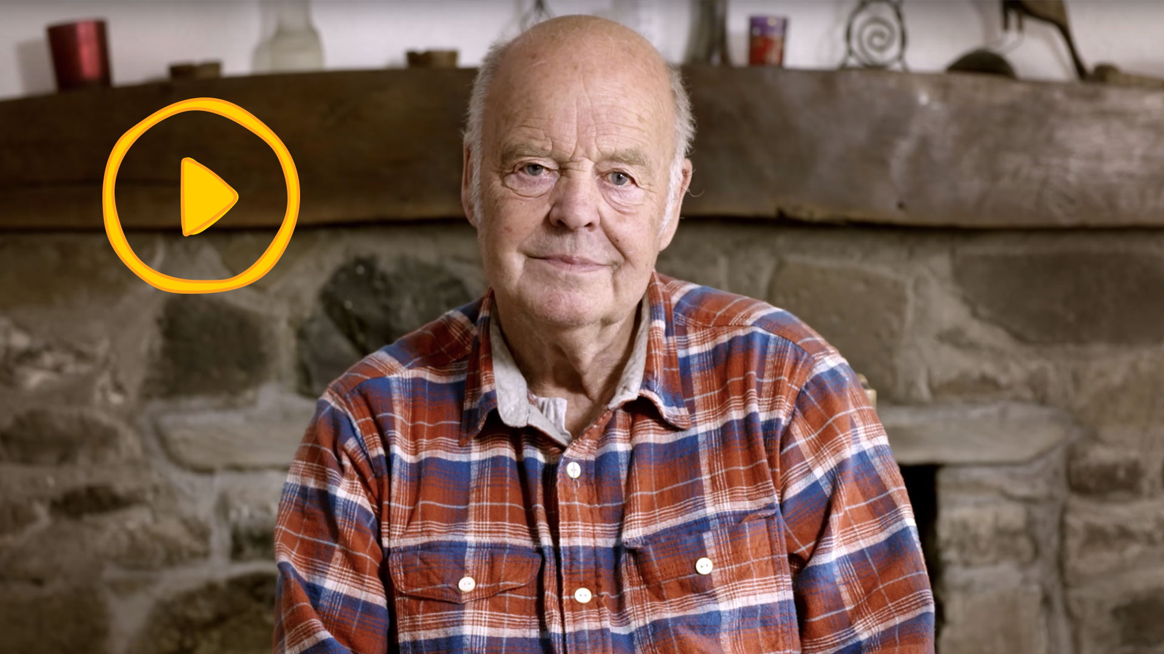
Life with a terminal illness

Slide 5
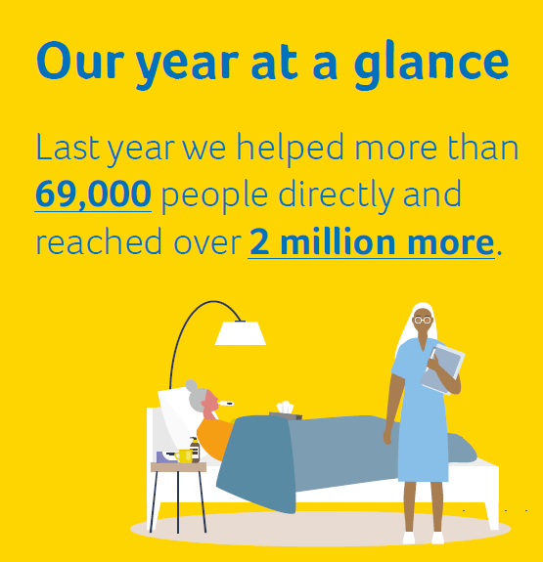
How we’re helping
    We provide expert care, guidance and support for people affected by terminal illness through our:
      Nursing service
      Hospices
      Helper volunteers
      Information and Support service.

Slide 6
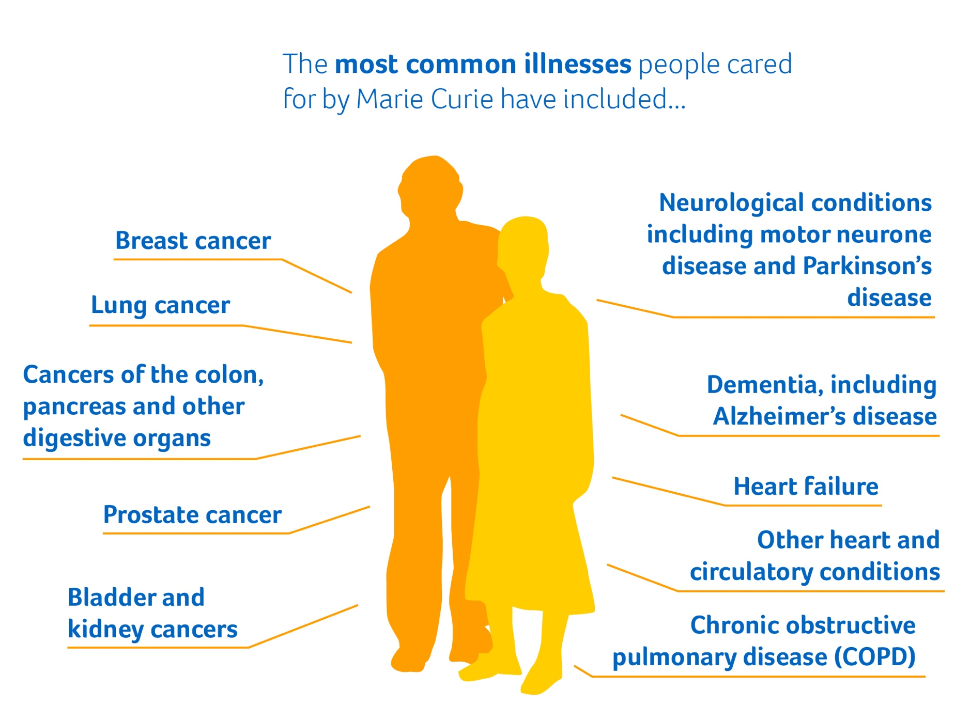
We’re here for everyone affected by terminal illness
    Someone has a terminal illness when they reach a point where their illness is likely to lead to their death.
    They may live for days, weeks, months or even years after this point.
    We offer care and support for people living with any terminal illness, and their families.

Slide 7
How we’re helping
    We provide expert care, guidance and support for people affected by terminal illness through our:
      Nursing service
      Hospices
      Helper volunteers
      Information and Support service.
Source: Mare Curie Annual Report 2021/21, published December 2022

Slide 8
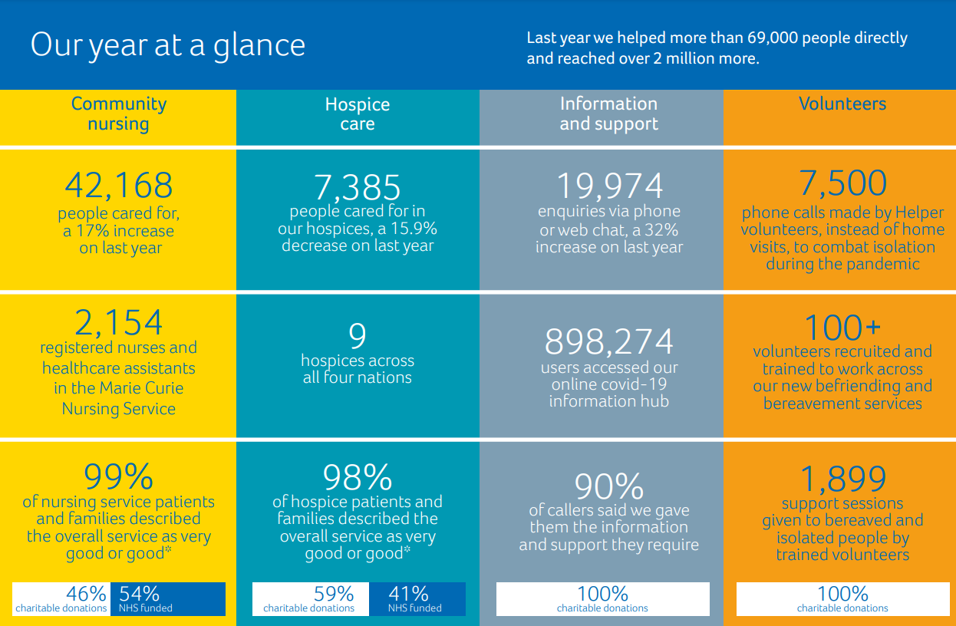

Slide 9
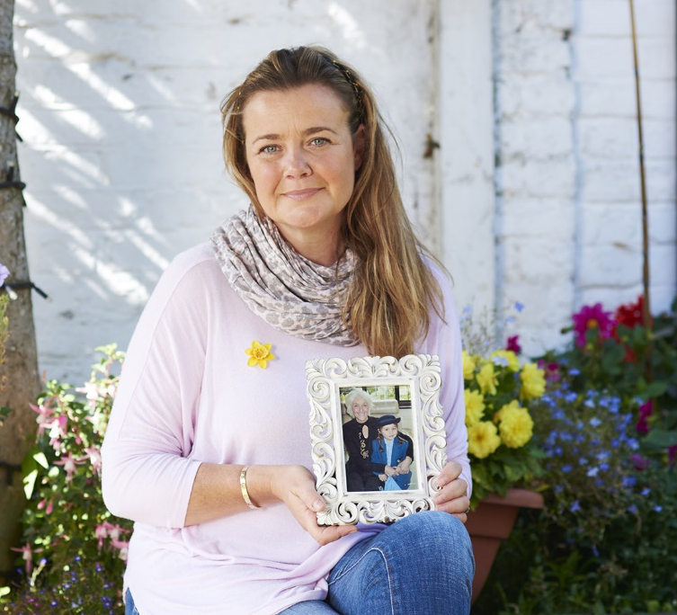
“Strength when it matters most”
    Louise’s mum, Pat, was cared for by a Marie Curie Nurse.
“It was all the things I had to do, like getting Mum out of bed or taking her to the toilet, or if she was being sick, and just giving her medication. It was only towards the end that I said: ‘I need help, I can’t do this on my own’.”
“A Marie Curie Nurse walked into my life, at 10pm in the evening. Just having her there at night was such a relief.”
“She gave me so much strength and helped me not to panic as Mum was taking her last breaths.”
Notes:
Louise Staceys Story:- https://www.mariecurie.org.uk/blog/pamper-party-mums-care/195956
Louise Stacey’s mum, Pat, was cared for by a Marie Curie Nurse, in her final days. Since then, Louise has been raising money for Marie Curie by organising pamper events.
Given the choice, most of us would want to spend our final days at home, surrounded by the people and things we love.
When Louise’s mum, Pat, was diagnosed with terminal bowel cancer, in 2009, this was her preference too.
Louise became her mum’s carer. But at the time, she was six months pregnant, with another young child to look after.
“What really shocked me was I was at home on my own with my mum.
“It was all the things I had to do, like getting Mum out of bed or taking her to the toilet, or if she was being sick, and just giving her medication.
“It was only towards the end that I said: ‘I need help, I can’t do this on my own’.”
Someone there to call on
To help her cope, she had support from Marie Curie, through the night.
“A Marie Curie Nurse walked into my life, at 10pm in the evening. Her name was Rose.
“Just having her there at night was such a relief. It meant that I could try and get some sleep.”
Strength when it matters most
“Rose was the Marie Curie Nurse on duty when my mum died and it was quite poignant because my mum’s mother was called Rose too.
“I have never forgotten her. She gave me so much strength and helped me not to panic as Mum was taking her last breaths.
“It meant I was calm enough to keep holding my mum’s hand, telling her not to be scared, that I was there for her and would always love her.”
 Pat, Louise's daughter Isla, and Louise on holiday.
The beauty in giving
After the care her mum received, Louise was determined to help other families have that support there too. She started holding fundraisers for Marie Curie and her most recent was a full-blown pamper party.
The ‘not to be missed’ event featured a prize draw raffle. “Lots of local business wanted to donate,” says Louise. “So, we had some really special prizes, including beauty treatments valued at £1,500.”
On the day, qualified therapists offered manicures, reflexology and massages. There were also stalls selling beauty products, clothing and jewellery, ran by local boutiques.
A va-va-voom tribute
A chance to get together, enjoy pamper treatments and have a fabulous time, the event was a fitting celebration of her mum’s life.
“Mum was very vivacious, totally va-va-voom. She was a very young 67 when she died – she didn’t look her age and really cared about her appearance. She was such fun."
Funding for the future
So far, Louise’s events have raised close to £50,000 for Marie Curie – helping her give back for the support she received, in a beautiful way.
“At the events, people can pop in for a bit of pampering, relax over a coffee and catch up with friends. And we can raise vital funds so Marie Curie Nurses can care for other people living with a terminal illness in their final hours.
“It’s a nice feeling knowing I’m making a bit of a difference. And I know Mum would be hugely proud. She would be thinking, ‘That’s my girl’.”

Slide 10
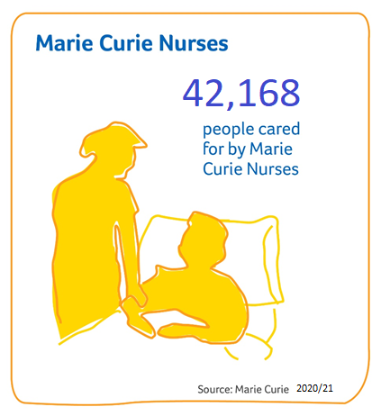
Marie Curie Nurses
    Marie Curie Nurses provide hands-on care and support in the comfort of people’s homes.
    Our nursing service allows people to stay at home for as long as possible.
    Marie Curie Nurses listen to people’s concerns and talk through their anxieties.
    Families caring for their loved ones can have time to rest.

Slide 11
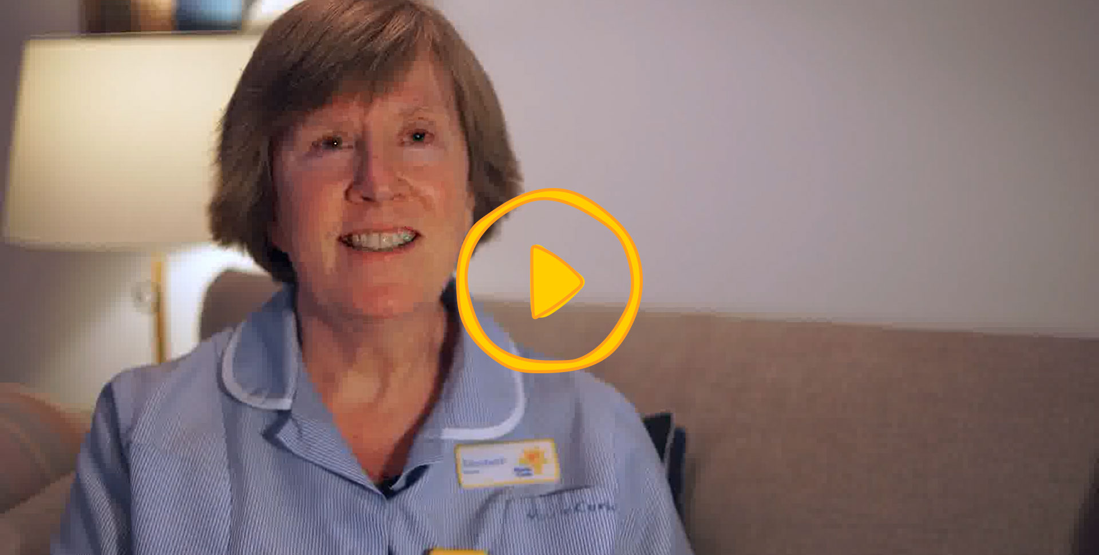
Marie Curie Nurse Lib explains her role

Slide 12
My Marie Curie Story

Slide 13
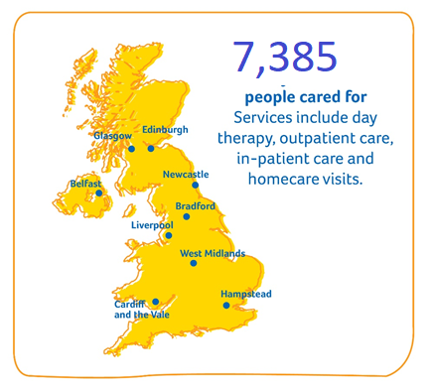
Marie Curie Hospices
    Our hospices provide specialist round-the-clock care and support in a friendly, welcoming environment.
    People can stay at the hospice or just come in for the day.
    Our doctors, nurses, therapists, social workers, chaplains and counsellors work together to help people have the best possible quality of life.
    We provide expert care, and practical and emotional support, tailored to people’s individual needs.

Slide 14
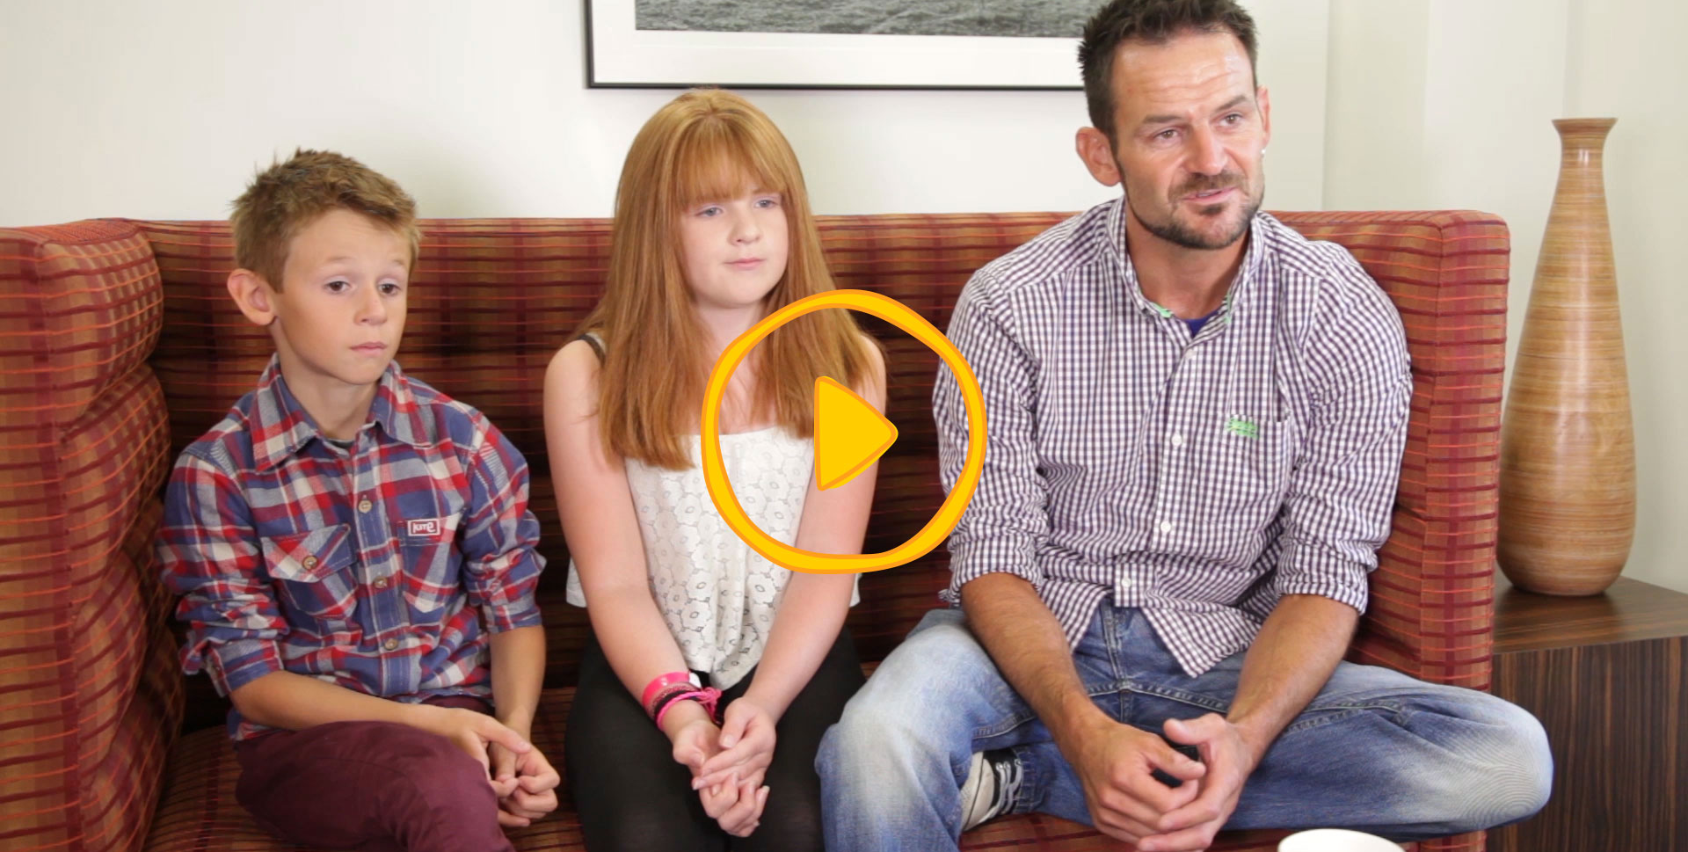
What are Marie Curie Hospices like?

Slide 15
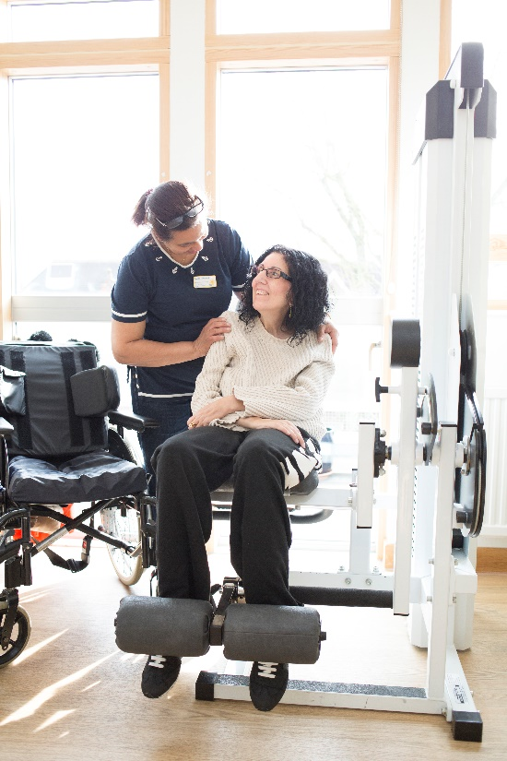
“I lost my old life to MND. The hospice helped me start a new one”
    Sarah was diagnosed with motor neuron disease at 34.
    “I was referred to the Marie Curie Hospice, Hampstead. I couldn’t imagine hanging out at a hospice.”
    “My regular GP seemed more scared of MND than I was, but the doctors at the hospice understood how I felt.“
    “I now use the gym twice weekly and I’m sure it has kept me more mobile. It’s become a part of my routine, which I think is good for me”
Notes:
Sarah’s Story:- https://www.mariecurie.org.uk/daffodil/sarah
Sarah Ezekiel was diagnosed with motor neurone disease (MND) at 34. The Marie Curie Hospice, Hampstead, has been a lifeline to her ever since. She tells us why the hospice means so much to her.
"When I was diagnosed with motor neurone disease in 2000, my first question was: ‘How will I care for my children?’ My daughter was three and I was seven months pregnant with my son. My neurologist assured me that I would – and I have, but it hasn’t been easy.
"Soon after diagnosis, my arms became very weak and I needed help to look after both my children and myself. Although I’m very grateful, it broke my heart watching strangers care for them. The disease progressed rapidly and I became dependent on other people. My marriage collapsed under the strain.“
A great comfort
"I was referred to the Marie Curie Hospice, Hampstead. I couldn’t imagine hanging out at a hospice and said I wasn’t interested. But I’d become painfully thin, couldn’t sleep and was very depressed. My brother made an appointment for me to see a doctor at the hospice. I was too weak to protest.
"My regular GP seemed more scared of MND than I was, but the doctors at the hospice understood how I felt. I was comforted for the first time since I’d been diagnosed. I now use the gym twice weekly and I’m sure it has kept me more mobile. It’s become a part of my routine, which I think is good for me.“
The right care
"Living as a severely disabled person causes complex difficulties. I’m fortunate to have survived much longer than most people with MND. The hospice supports me in every way. I lost my old life, but they helped me to start a new one. The right care is so important when you have a terminal illness.
"Many people believe hospices only help people with cancer, but they do a great deal for patients with MND, too. That’s why I think it’s crucial that research is done to make sure palliative care is available to people with MND. It’s not always recognised that we need that holistic approach to care, too.“
A new lease of life
"In March 2012 I discovered that Eyegaze technology – the computer I use to communicate – can be used to draw and paint. Keen to try, I downloaded the software. Having studied art and history of art at A-level and started an art foundation course, I had always wanted to be a fine artist. Travel, marriage, babies and MND followed and my dreams of being an artist ended – or so I thought.
"Once I started painting, I couldn’t stop – I wanted to create constantly. I painstakingly select tools and colours with my eyes. My surroundings become more colourful and I feel as if I have a new lease of life. After posting my work on social media, people asked if they could buy it. Now I’ve exhibited all over the UK. I still need to perfect my technique and I’m never completely content with my work, but I still can’t believe that I can paint with my eyes!
Dignity and peace
"I can’t imagine my life without the hospice. MND terrified me at first, but I no longer fear it. The hospice has also supported my children, who were traumatised by my illness. They’re now well-balanced and wonderful young people, and I’m so grateful they emerged unscathed.
"I believe that the hospice will make my death as painless as possible, which was one of my worries after diagnosis. It’s good to know that, when the time comes, I’ll be able to pass away with dignity and peace."

Slide 16
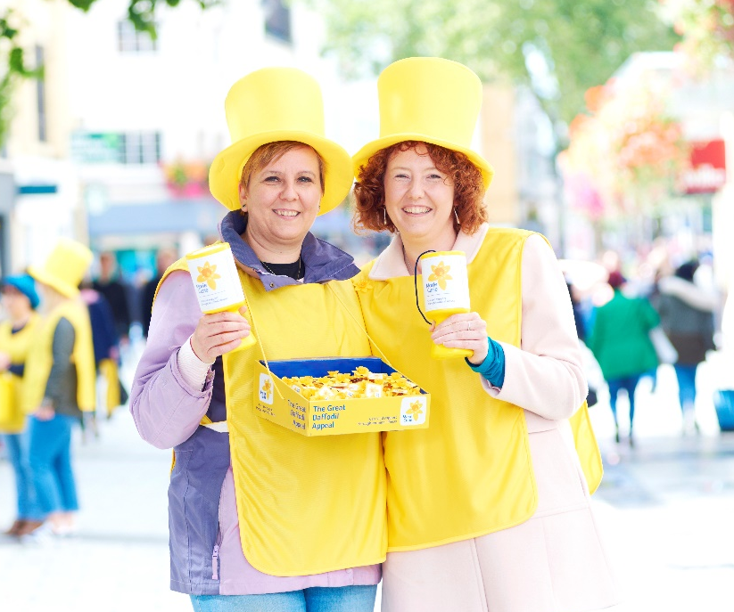
“I remember her settling down and just saying: ‘This is what I wanted.’”
  Sian and Sarah Higson’s Mum Shirley was diagnosed with stomach cancer in May 2016
"The hospice is such a peaceful place and everyone there is just lovely. Everyone you met there took the time to smile and ask how you were..”
"The nurses were kind, caring and patient. They’d walk in and hold Mum’s hand, talking to her like a human being”
Notes:
Sian’s and Sarah’s story: - https://www.mariecurie.org.uk/daffodil/sian
Sian Higson’s mum Shirley was diagnosed with stomach cancer in May 2016. Here, Sian talks about the amazing bond they had, and how laughing at happy memories helps the family through difficult times.
"Mum had been going back and forth to the doctors. She was struggling to eat and had been sent for tests. The results came back and we were told she had inoperable cancer. ‘There’s nothing they can do for me,’ she told us. ‘So I want to spend whatever time I have left with my family now.’
"We promised her we’d be there to hold her hand and support her through it. She was amazing – so strong and courageous.
"We always talked openly about what was happening and Mum even planned her own funeral. ‘I don’t want you children worrying,’ she said. She planned the songs and chose the flowers herself. We never had to question what Mum wanted, because she’d told us.“
Making memories
"When Mum was well enough, we did lots of things together to create new memories. She liked going to Tenby in the west of Wales. It’s a seaside town. She wanted to make memories with us all and she’d document everything.
"She loved her grandchildren, Ffion and Evan. She’d looked after Ffion since she was a baby, so they had a very close bond.
"Mum kept us all strong. She’d retired at 60 after working in retail for 10 years. Before that she’d had various jobs – catering, waitressing. She worked hard.
"She wanted to go into the hospice because she didn’t want to burden us. We were happy to take care of her – we wanted to take care of her – but she wanted to be in the hospice.“
Kind, caring and patient
"The relief that Mum felt when she was admitted was amazing. I remember her settling down and just saying: ‘This is what I wanted.’
"The hospice is such a peaceful place and everyone there is just lovely. Everyone you met there took the time to smile and ask how you were. There was constant reassurance that you weren’t alone in this.
"The nurses were kind, caring and patient. They’d walk in and hold Mum’s hand, talking to her like a human being. We could go and see her whenever – that meant a lot.“
Staying strong
"The morning Mum died, we were there. My sister Sarah, brother Gareth, sister-in-law Lisa and I sat by her bed. Gareth and Lisa popped out for a bite to eat. When they came back, Sarah said: ‘Gareth and Lisa are back, Mum.’ And she just slipped away. It was like she was waiting for them to return.
"A nurse came in and said: ‘Your mum was such a lovely lady, and you’re such a strong family. I can see the love you all have for each other.’ It was all Mum would have wanted.
"She told us to be strong. We’re doing OK. We have our moments. One minute you’re crying your heart out, the next you’re laughing at the happy memories. It’s like we have an invisible cord – when one person is down, we lift each other up."

Slide 17
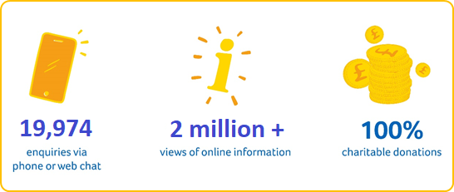
Getting support when you need it
      Marie Curie Support Line:
      0800 090 2309 or online chat
      Online information: mariecurie.org.uk/support
      Marie Curie Community: community.mariecurie.org.uk

Slide 18
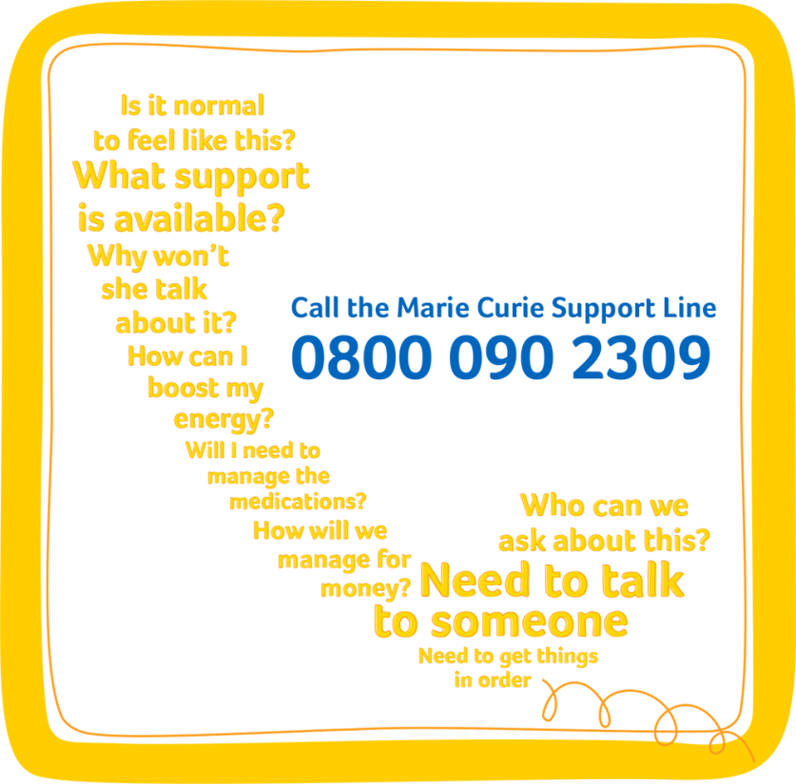
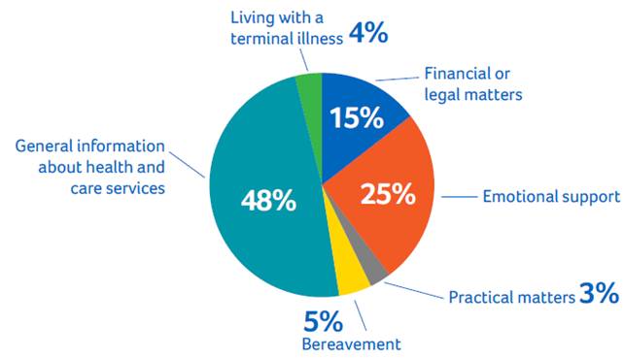
Getting support when you need it

Slide 19
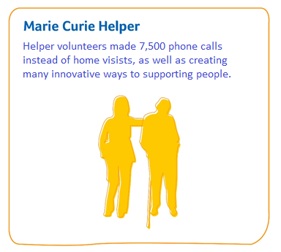
Marie Curie Companion Service
    Companionship and practical support from our friendly, caring Helper volunteers.
    During Covid this service adapted and offer support over the phone.
    Traditionally our trained volunteers:
      Visit people in their homes for a few hours each week offer companionship and a friendly ear
      Provide practical support such as helping people get to an appointment or go shopping.
Notes:
Check with your community fundraiser, if the Helper Volunteer Service operates in your area.

Slide 20
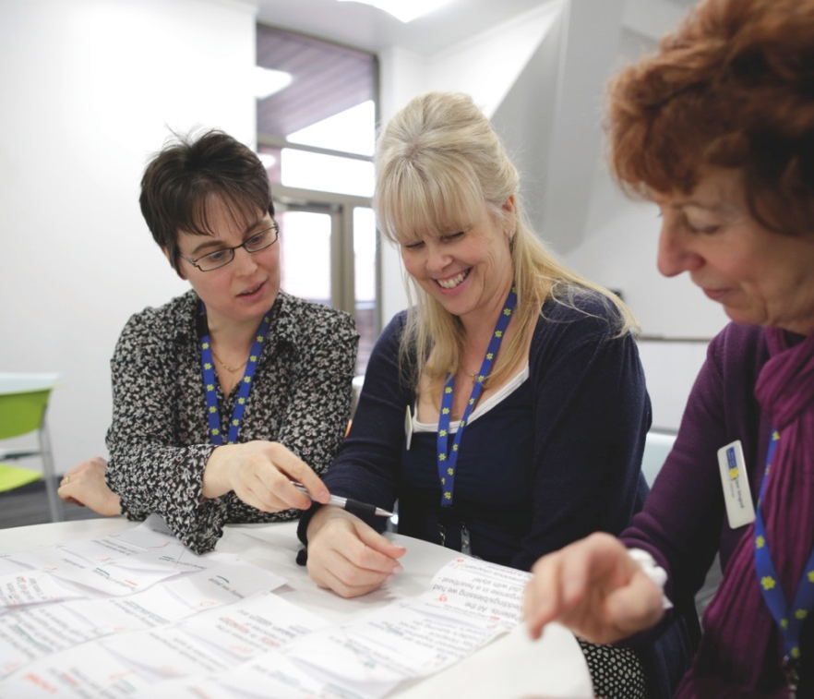
Our work on policy and research
      Campaigning for better care and support for people affected by a terminal illness.
      Leading research into better ways of caring for people living with a terminal illness.

Slide 21
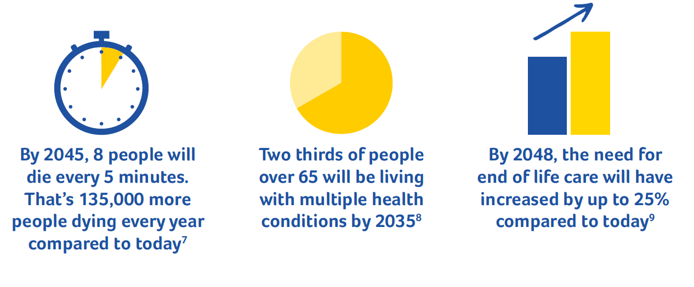
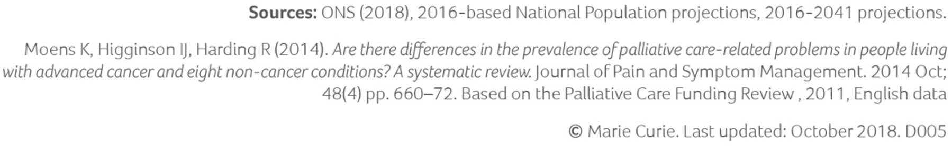
The challenges we’re facing

Slide 22
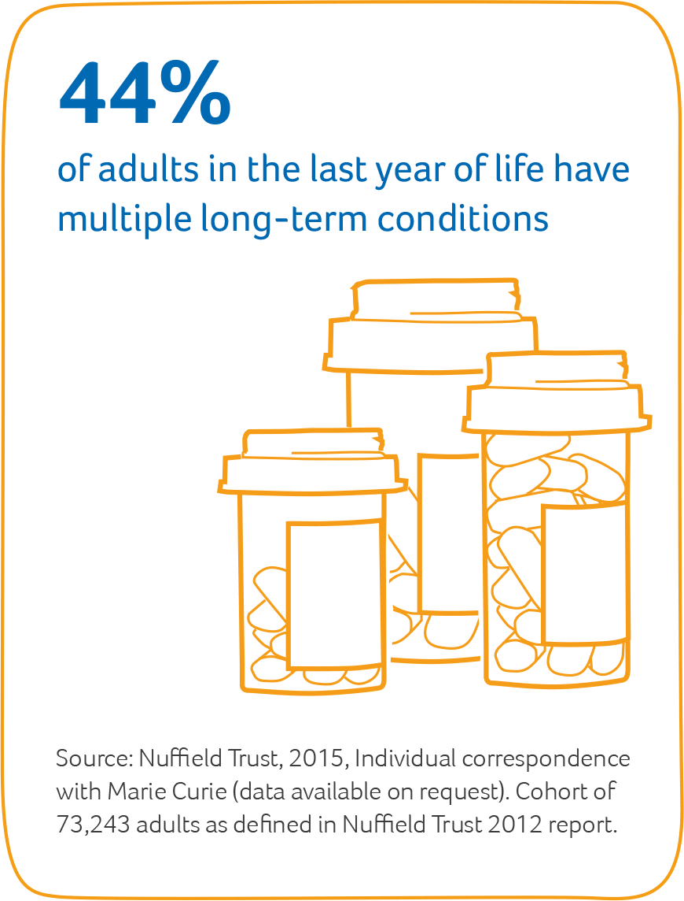
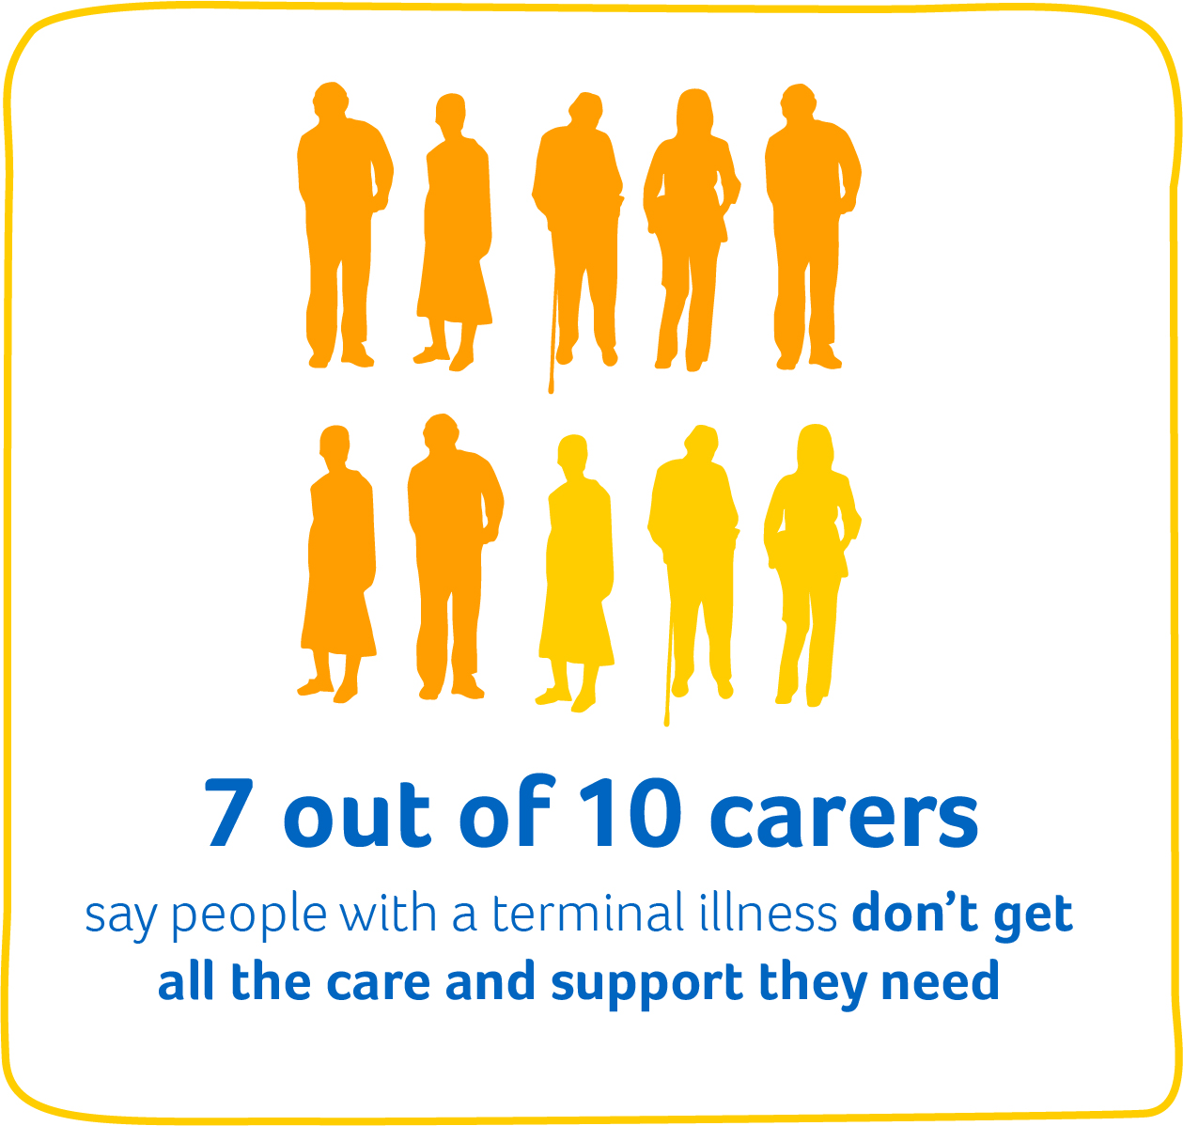
The challenges we’re facing

Slide 23
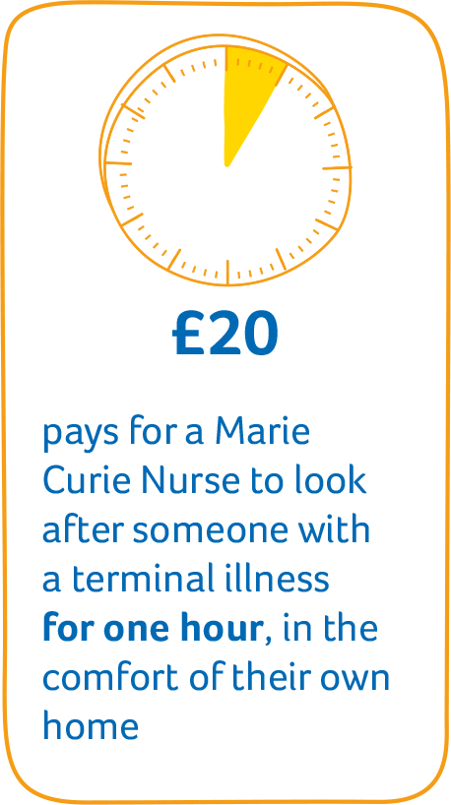
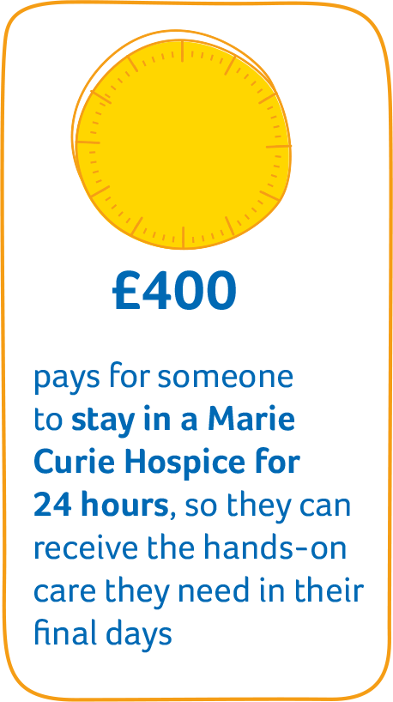
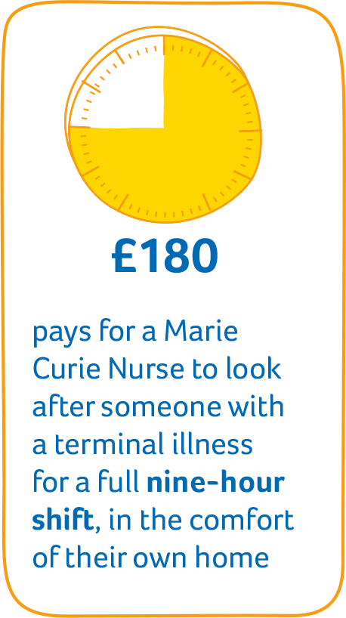
The difference your support can make
£23
£207

Slide 24
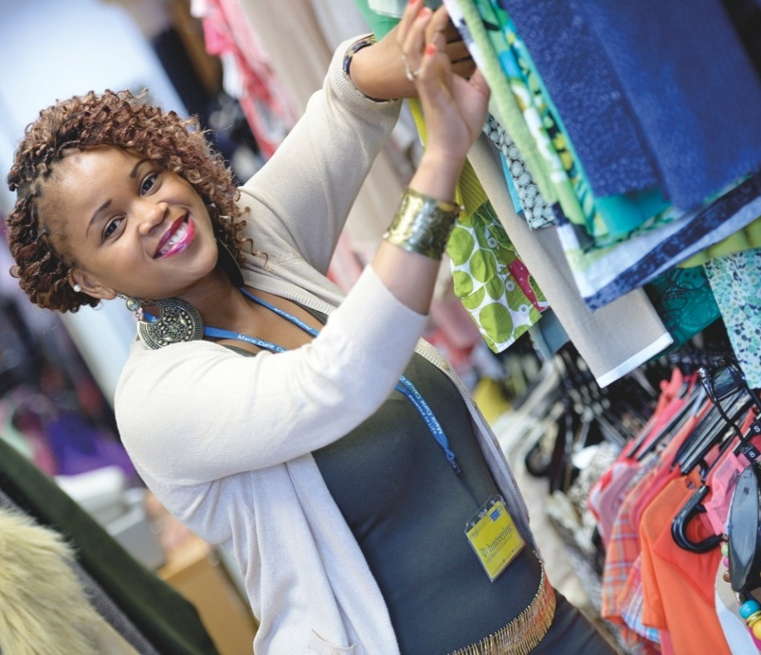
How you can support us
    There so many ways you can help us. You could:
    Make a donation
    take part in our fundraising events
    organise your own fundraising activity
    get your company, school or network involved
    become a volunteer
    leave a gift in your Will.
Notes:
Please select 3 suggested ways for your audience to get involved, or add in other suggestions which you have agreed with your community fundraiser. Do edit this page.

Slide 25


Quote or key message layout. Adjust the quote marks up or down according to the length of the text. The second quote mark should appear at the baseline of the quote
  Speaker name, title

Slide 26
Short punchy quote or key message and adjust the quote mark objects up or down to fit the text.
  Speaker name, title

Slide 27
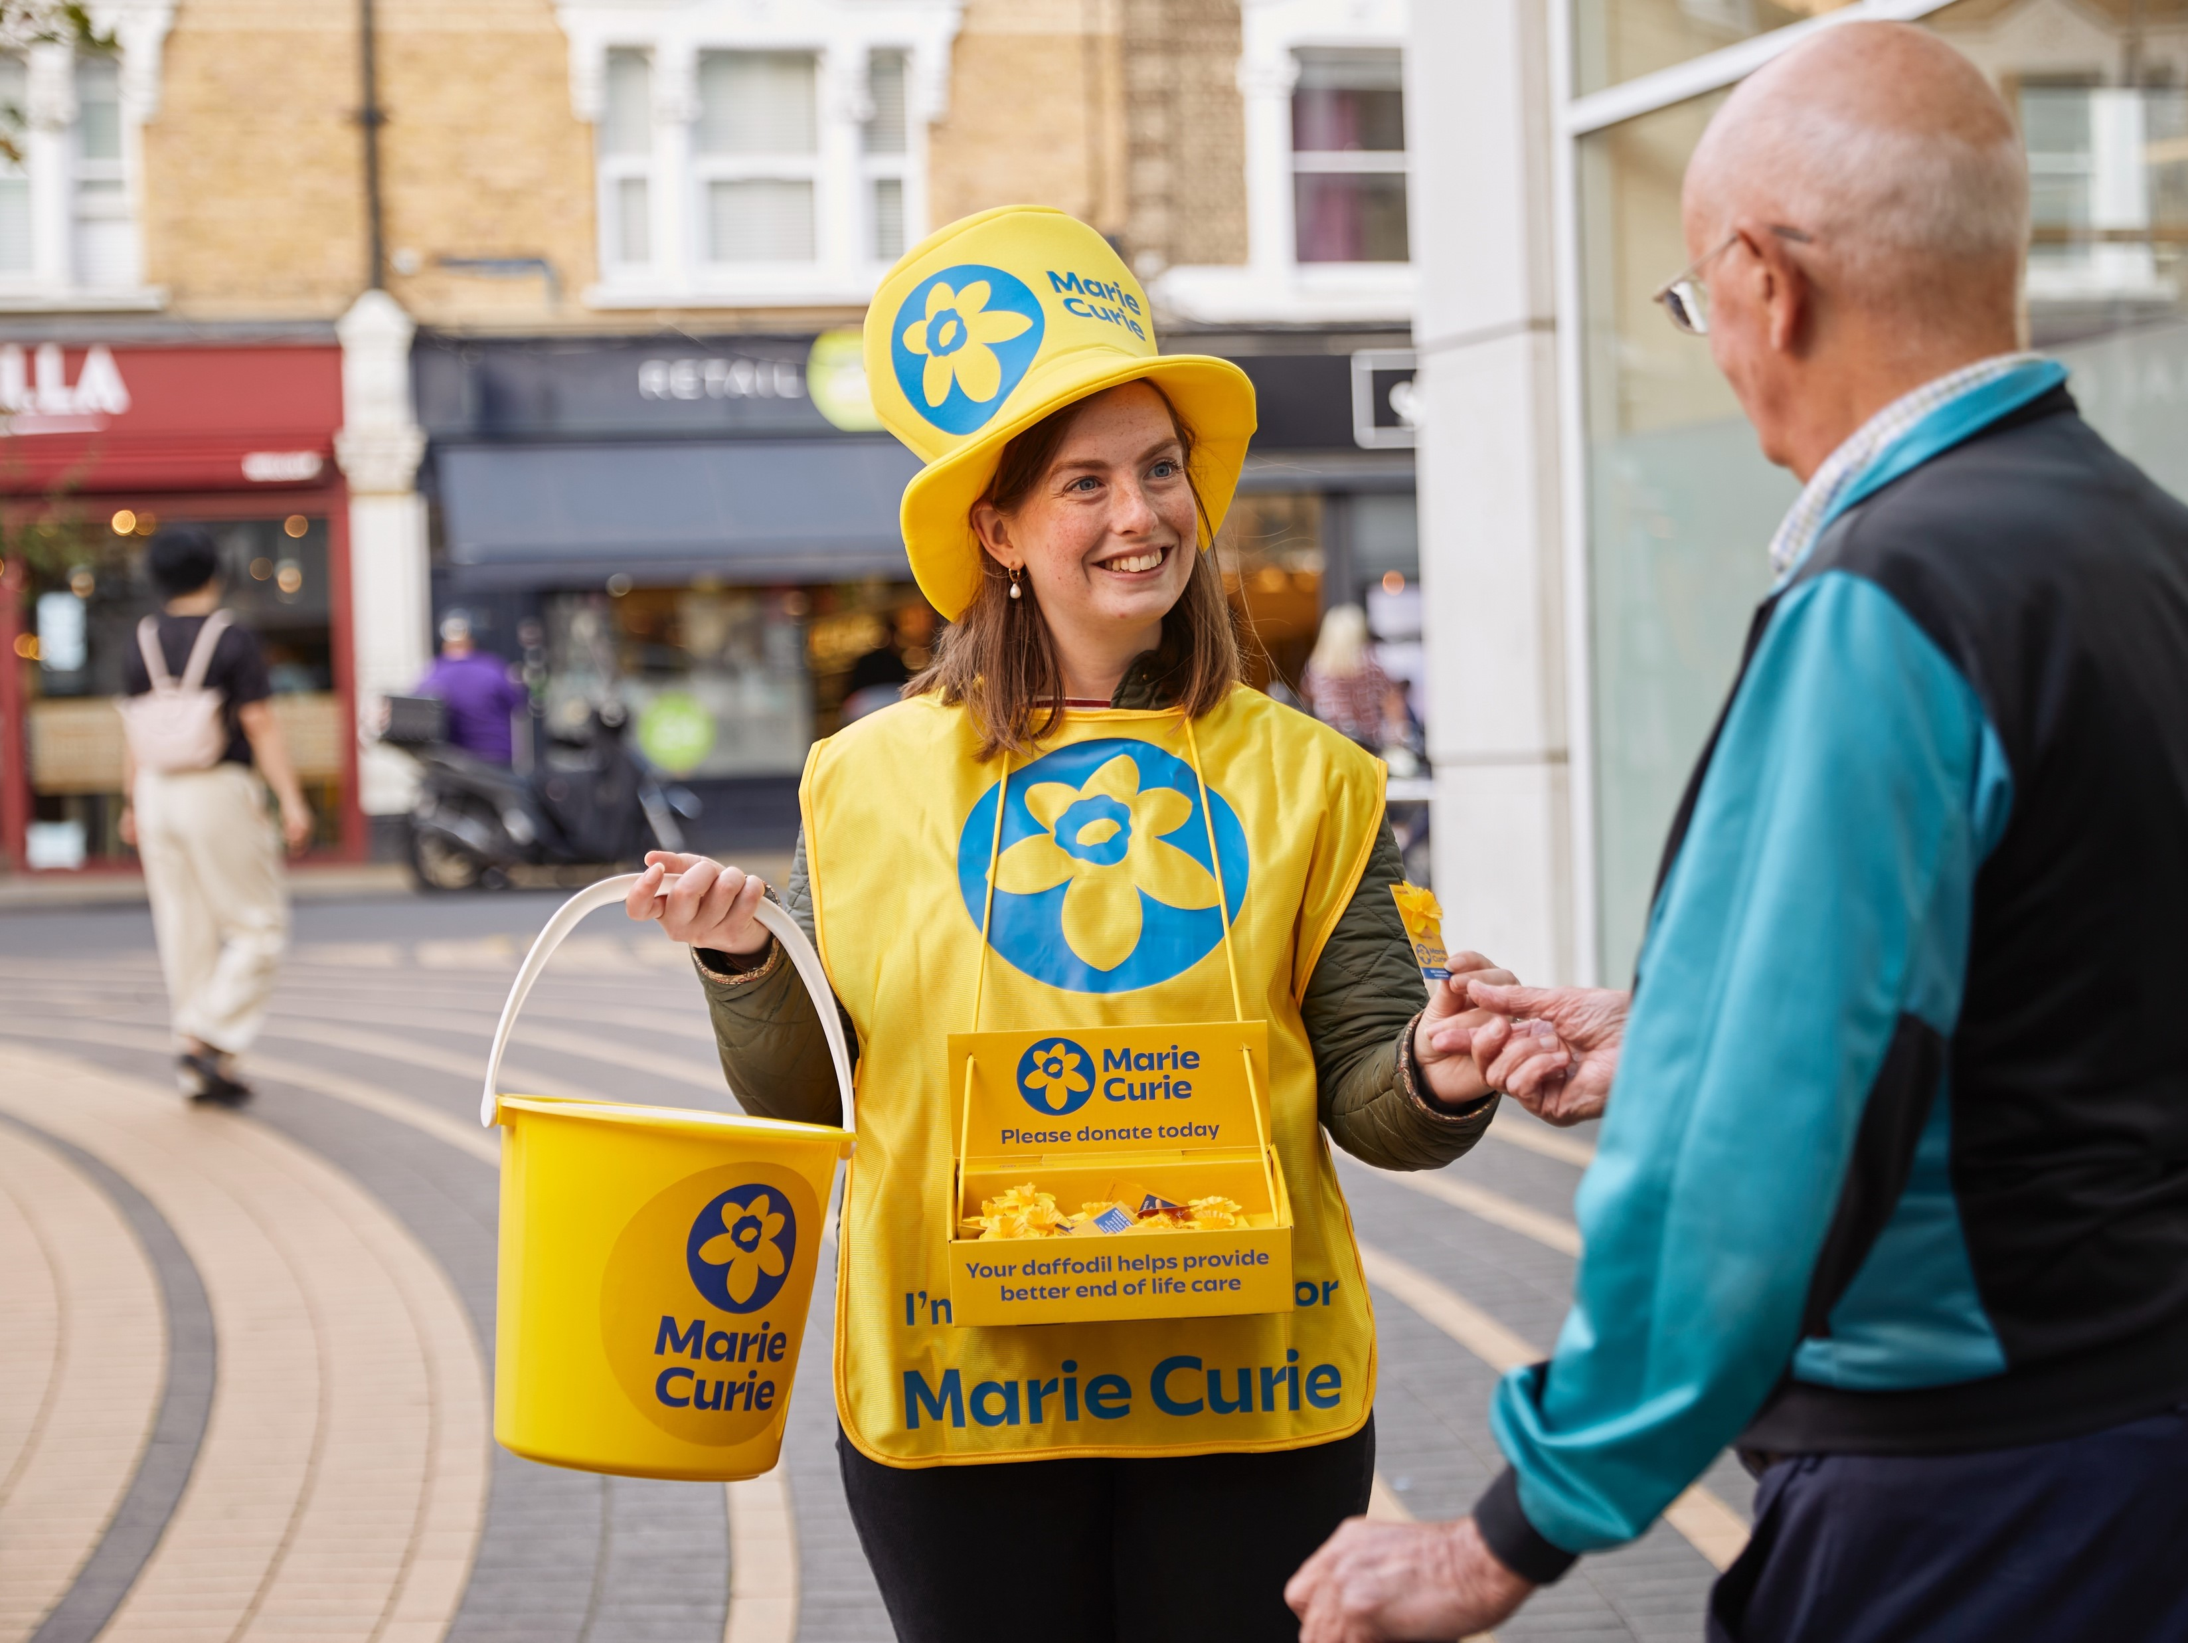
Notes:
Instructions:
Select petal border object and go to Picture Format> Send Backward> Send to Back
Select main background photo and press Delete key so the image is removed
Inside the empty content placeholder, click the “Insert Picture” icon in the centre to insert a new image
Select the newly inserted image and go to Picture Format> Send Backward> Send to Back – so that the petal border object appears over the top of the background image.

