Slide 1



A palliative approach to multiple sclerosis: Benefits and barriers to care
Monday 30 April 2018
#MSPallCare

Slide 2
Patricia Gordon
Director
MS Society Northern Ireland
#MSPallCare

Slide 3
MS Symptom Burden

Slide 4
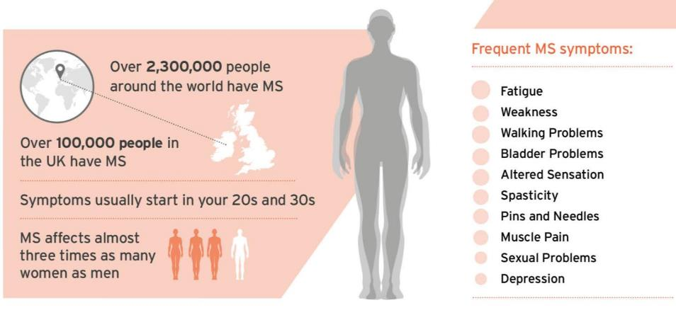
Multiple sclerosis
Notes:
MS is a neurological condition that affects over 2 million people worldwide and over 100,000 people in the UK.
Affects 3 times as many women as men – reasons unknown but possibly hormonal
List of symptoms are long and varied. Just because you’ve met one person with MS does not mean you understand the condition

Slide 5
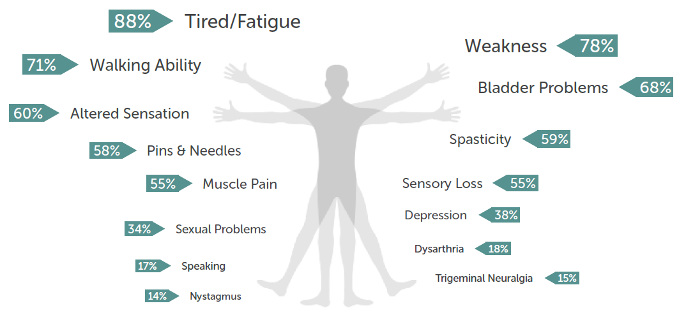

Symptoms of MS
Notes:
Researchers have asked Register participants about the symptoms that they experience, giving us an idea of how common particular symptoms are.
This kind of information is vital for us to build a better picture about how MS affects people’s lives, and what we can do to help.
For example, 88% of participants reported experiencing tiredness/fatigue. Finding effective treatments for fatigue is one of our top research priorities.

Slide 6
The science of MS
Notes:
To understand why symptoms are so variable, we need to look at the biology of MS

Slide 7
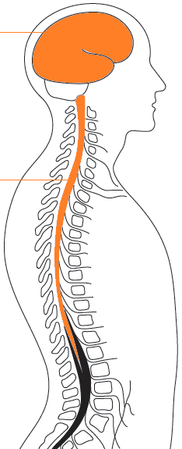
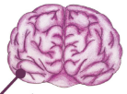
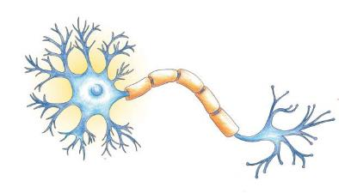
Your central nervous system
brain
spinal cord
neurons
Notes:
MS affects the central nervous system, made up of brain and spinal cord. Composed of billions of neurones (or nerve cells)

Slide 8

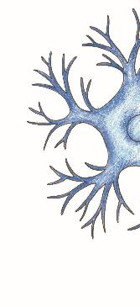
What do nerve cells do?
nerve cell fibre (axon)
cell body
myelin
messages travel along nerve fibre
Notes:
Nerve cells are responsible for transmitting messages around the body
Messages come to the cell body, travel along the nerve fibre and are transmitted to other neurons by synapses.
Nerve fibres are protected by a special fatty substance called myelin (which wraps around the nerve fibre like a Swiss roll). As well as making the message travel faster and more efficiently, myelin also protects the nerve fibre from damage (like the insulation around an electric wire)
In MS, the myelin is damaged

Slide 9

What happens in MS?
cell body
Blood-brain barrier
Notes:
Throughout the body we have a network of blood vessels deliver nutrients to all of our tissues, including the brain.
Immune cells circulate in the blood, where they patrol the body and fight infections.
They are normally kept out of the brain by the blood-brain barrier.
But in MS, immune cells enter the brain and spinal cord, where they mistake myelin for a foreign substance and attack

Slide 10
Myelin damage
messages are disrupted
Symptom that arises depends on where in brain or spinal cord damage occurs
Notes:
Myelin damage slows down and disrupts messages
Depending on where this damage occurs in the brain and spinal cord, this can lead to a variety of symptoms including fatigue, problems with balance and walking, memory and thinking
Our body is however naturally capable of putting myelin back on nerves. We all have stem cells in our brain and spinal cord that sense myelin damage, gather in the area and then become specialised myelin making cells called oligodendrocytes. These cells can then repair the myelin damage.
Symptoms seem to improve (in relapsing remitting MS)
Unfortunately this process of myelin repair becomes less effective over time…

Slide 11
Progression
cell body
messages cannot be sent

Slide 12



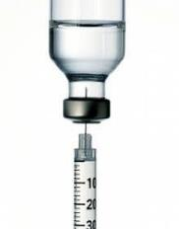
MS symptoms

Slide 13
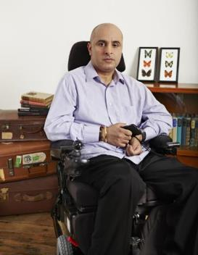
The social impact of MS in the UK
    100 people diagnosed each week
    Estimated £4.2 billion each year
    2012 report:
      59% say MS negatively affected self-confidence
      Detrimental impact on their general happiness and wellbeing.
Notes:
https://www.mssociety.org.uk/sites/default/files/Fighting%20Back%20-%20MS%20Week%202012%20report%20-%20spreads.pdf

Slide 14
The social impact of MS in the UK
“Being fatigued limits the speed at which I can work… If I get too hot in the office this can also cause increased fatigue, sickness and difficulties moving around the office safely.
Many days I struggle to concentrate or think straight and this means I forget to complete important tasks, or lose my train of thought mid-sentence when instructing colleagues.
Due to nerve pain and visual difficulties caused by optic neuritis, I have been provided with specialist equipment in the office... If I become too fatigued and run down, this can also impact my mental health, which means I can become quite down and struggle to get up of a morning and perform efficiently at work.”
Amy, person with MS
Notes:
https://www.mssociety.org.uk/sites/default/files/Employment%20that%20works%20-%20APPG%20report.pdf

Slide 15
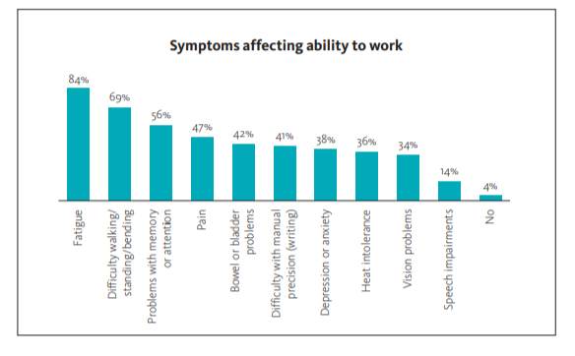
Impact on work
    Up to 80% of people with MS retire within 15 years of diagnosis
Notes:
https://www.mssociety.org.uk/sites/default/files/Employment%20that%20works%20-%20APPG%20report.pdf

Slide 16
Impact on carers
2015 survey:
69% of people with MS had help from family
  average 19 days a month, 5 hours a day
This increased with disease severity
  86% of most severe group relied on family support, on average 24 days a month, 7 hours a day
Can significantly impact on quality of life of carer
  Particularly where family income lower or MS more severe
Notes:
Thompson, Kobelt et al. Multiple Sclerosis Journal. 2017, Vol. 23(2S) 204–216

Slide 17

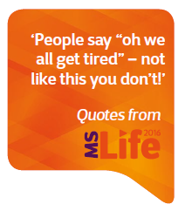
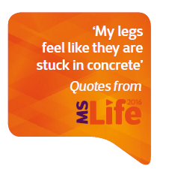

Over 80% of people with MS experience fatigue
    Main factor contributing to people with MS leaving work

Slide 18
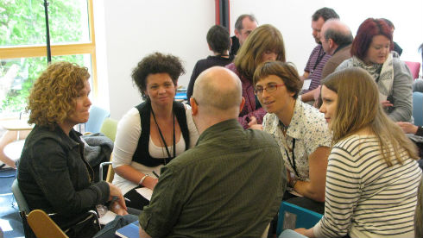
Fatigue Management
FACETS
Group based fatigue management
Cognitive Behavioural Therapy + ‘energy effectiveness’ approaches = reduced fatigue levels
Notes:
FACETS fatigue management programme was developed by researchers at Bournemouth University and Poole Hospital NHS Trust, for people with MS in their local area.
FACETS = Fatigue: Applying Cognitive behavioural and Energy effectiveness Techniques to lifeStyle
Developed by Dr Sarah Thomas and colleagues at Bournemouth university
The programme has shown that using a combination of cognitive behavioural therapy and ‘energy effectiveness’ approaches (such as prioritising tasks) reduced people’s fatigue levels.
Health professionals are now being trained in the FACETS programme, to use their new skills to help people who experience MS fatigue far and wide across the UK.
Over 200 health professionals have been trained so far. And a recent survey suggested that more than 1,500 people with MS have already attended a FACETS programme – Correct as of Feb 2017.
(https://www.mssociety.org.uk/ms-research/research-blog/2017/02/mind-gap-getting-care-and-services-research-clinic)
Can a flavonoid-rich cocoa drink improve fatigue?
We are also funding a study that will investigate whether dark hot chocolate could help to reduce fatigue for people with MS.
This is based on previous research showing that compounds called flavonoids, which are found in chocolate, could help to reduce inflammation and damage, which may be linked to fatigue.
The study will be testing flavonoid rich hot chocolate versus a low flavonoid alternative in 40 people with MS. This research is led by Professor Helen Dawes at Oxford Brookes University.
Also, as part of our Clinical Trials Working Group Rona Moss-Morris and her team have completed a systematic literature review examining the potential interventions useful for Fatigue, exercise is one of these and they are currently working on a NIHR grant application to secure funding for an interventional study including exercise and behavioural components to combat fatigue.

Slide 19
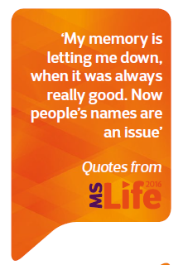
Cognitive changes
Cognition – memory, decision, concentration
Affects around 50% of people with MS
Early cognitive changes in MS could be linked to a higher risk of progression
Notes:
Many people with MS experience problems with cognitive processes
Cognition refers to memory and thinking. Cognitive processes include our ability to concentrate, multitask, make decisions and remember information.
Unfortunately there are few effective treatments available for these symptoms.

Slide 20

Cognitive Rehabilitation
Cognition – memory, decision, concentration
CRAMMS trial
Test whether group cognitive rehabilitation sessions can improve quality of life for people with MS
Involves 400 people with MS
Began in 2014
Managing cognitive changes
Identifying changes so people are offered the best treatments
Notes:
What research is happening
The CRAMMS (Cognitive Rehabilitation for Attention and Memory in people with MS) trial is a NIHR funded trail running out of the University of Nottingham, it will test whether a weekly group cognitive rehabilitation programme can improve quality of life for people with MS.
The group sessions (led by a psychologist) will focus on strategies to improve attention and reduce memory problems in daily life. They will explore the benefits of using internal (such as mnemonics) and external memory aids (such as diaries, mobile phones and cameras)
CRAMMS is the largest UK symptom management clinical trial in MS
If the study confirms the benefits of cognitive rehabilitation it could lead to a change in clinical practice in the UK that could help people experiencing cognitive problems
Our cognition research
We’re also funding 2 PhD projects that are linked to the CRAMMS trial. One of our students will look to learn more about people’s perceptions and experiences of cognitive rehabilitation therapy, and the other will assess the best way to ensure that the programme is adopted by health care professionals if it is successful.
Finding new ways to measure cognitive changes in people with MS
A study led by Dr Robert Dineen at the University of Nottingham examined MRI as a potential predictor of cognitive performance as measured by a paced auditory serial addition task (PASAT)
Right now there are few effective treatments for cognition, and no reliable way to measure someone’s response to treatments in a clinical trial
This study involved a careful systematic review of the literature and found that there was a significant association between cognitive function and changes to white matter pathways.
A project led by Roshan das Nair, who is also highly involved in the CRAMMS trial, was also awarded MS Society funding last year. This project is aimed at Developing an evidence-based cognitive screening pathway for people with Multiple Sclerosis which could help clinicians and pwMS identify cognitive problems that could benefit from further cognitive assessment and/or cognitive rehabilitation.

Slide 21
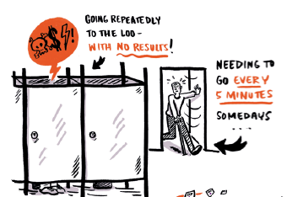
Bladder problems
Bladder problems affect approx. 70% of people with MS at some point
Incontinence
Feeling of urgency
Incomplete bladder emptying
Frequent UTIs

Slide 22
Managing bladder problems
Bladder problems affect approx. 70% of people with MS at some point
Botox for bladder
Now licenced in the UK
Botox injections shown to be a safe and effective treatment for overactive bladder
Early clinical trial funded by MS Society
Reducing UTIs We’re funded a number of projects developing ways to reduce the risk of infections
Notes:
We have been supporting bladder research since 1960, funding over 30 projects (nearly £2 million). This includes early research into the potential of Botox injections as a treatment for overactive bladder conducted by Clare Fowler and her team in UCL.
Botox for bladder
How does it work? Botox is injected in the overactive muscles in the wall of the bladder, helping it to relax
Clinical trials have shown that Botox is highly effective at reducing the frequency and urgency with which people need to urinate.
The treatment results last for around 10 months, at which point the treatment can be given again.
Additional information on Botox:
The treatment is not first line – it’s given when other treatments have failed.
If you are having problems accessing Botox, have a look at our access to medicines guide on our website
It is expected that some people will still need to self-catheterise while using the treatment
Our bladder research projects
Understanding urinary tract infections in MS using a model bladder
Urinary tract infections (UTIs) are a common complication for people with MS. Long-term antibiotic treatment can help to reduce symptoms, but this can come with significant side effects.
We have funded two research projects recently by teams led by Dr Jennifer Rohn and Prof. James Malone-Lee at UCL.
They developed a model bladder in the lab to help us understand more about UTIs in MS. They will use the model to identify pathways that are linked with chronic infections.
They are also using this knowledge to develop new more targeted treatments for UTIs for people with MS.
Using pelvic floor muscle training to manage incontinence in progressive MS
Nikki Cotterill and team looked at the prevalence of bladder and bowel continence issues for people with progressive MS and current treatment practices. This review concluded that people with Progressive MS often experience bladder and bowel continence issues and these issues can arise at the same time.
Some early stage research has shown that pelvic floor muscle training (PFMT) can improve both these symptoms in people with MS.
This research is still underway at Bristol Urological Institute and we will hopefully get an update on results soon.

Slide 23
Together to beat MS
Our Vision
A world free from the effects of MS.
Our Mission
To enable everyone affected by MS to live life to their full potential and secure the care and support they need, until we ultimately find a cure.

Slide 24
Dr Gavin McDonnell
Consultant Neurologist
Belfast Health and Social Care Trust
#MSPallCare

Slide 25
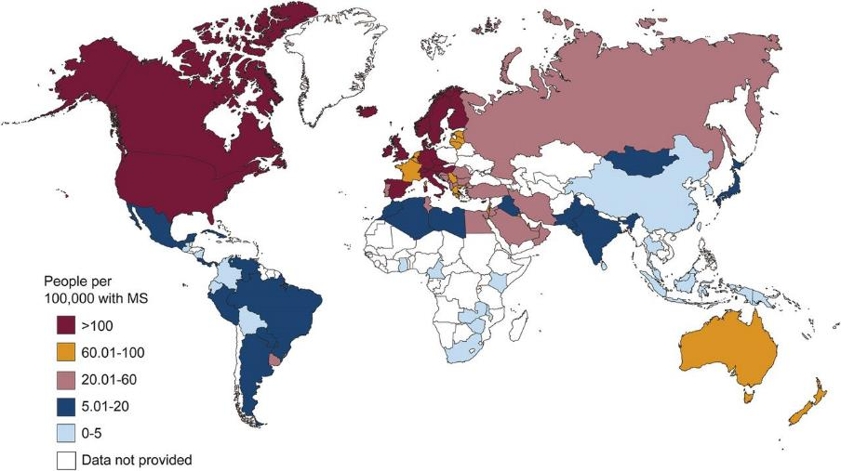
Global prevalence of MS in 2013 (MSIF)
Browne et al. Neurology 2014;83:1022-1024

Slide 26
Some numbers
Highest prevalence for male MS in the UK
2nd highest prevalence for female MS in the UK
2004: estimated prevalence 230/100,000
  138/100K in 1986
  168/100K in 1996
Currently est. ~4,500 MS patients in NI (pop 1.8 million)
Incidence estimate ~11/100,000 (200 new cases/yr)
Globally, prevalence estimated to be increasing by 2.5% per annum

Slide 27

N.Ireland has as many MS patients as one would expect in a region with a population of ~3.0 million in GB
100,000 MS Patients
~4500 MS patients
If everywhere in the UK had the same prevalence rate as N.Ireland there would be 160,000 MS Patients

Slide 28
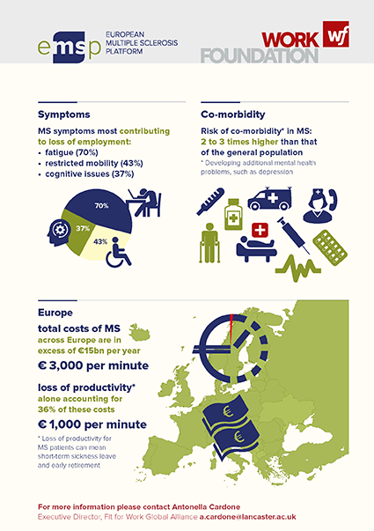
Societal Costs of MS

Slide 29
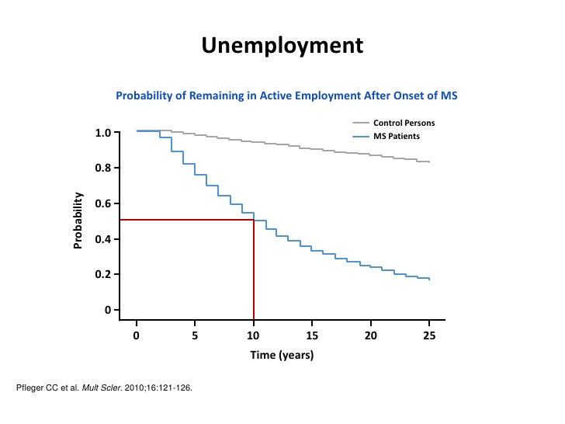

Slide 30
ABN Guidelines 2015
Categorisation of DMTs
Pract Neurol 2015;15:273-279 Scolding et al
Category 1
Drugs of moderate efficacy
Category 2
Drugs of high efficacy
β-interferons
  Incl ‘pegylated’ β-interferon
Glatiramer acetate
Teriflunomide
Dimethyl fumarate
Fingolimod
For patients with “active” disease
≥2 clinical relapses in previous 2 yrs
Nod to those patients with active disease on MRI grounds
Natalizumab
Alemtuzumab
“patients with more active disease”
Frequent clinical relapses +/- MRI activity either untreated or on Category 1 drug
Given its potential adverse effects “alemtuzumab should be mainly confined to patients with more active disease”

Slide 31
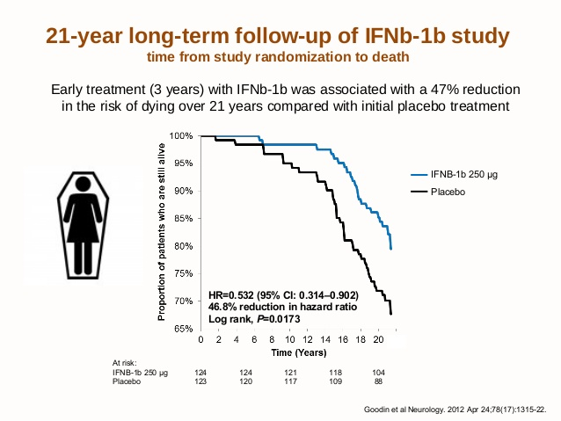

Slide 32
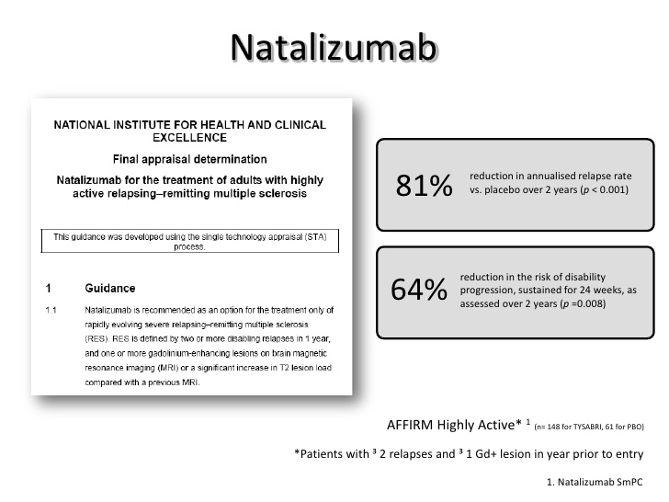

Slide 33
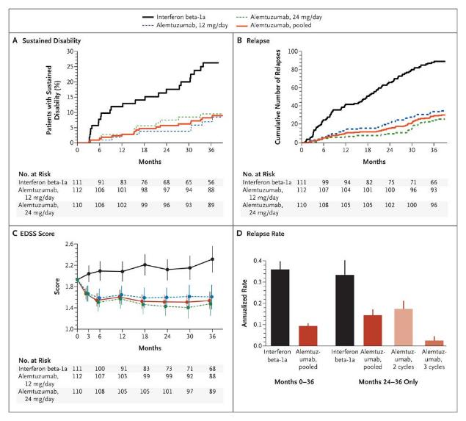
Alemtuzumab
Efficacy Measures Regarding Disability and Relapse at 36 Months
The CAMMS223 Trial Investigators. N Engl J Med 2008;359:1786-1801

Slide 34
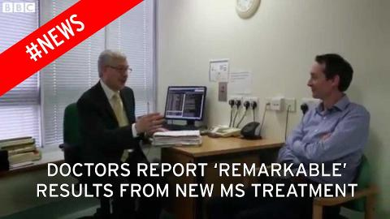

Slide 35
.....but we don’t have a cure yet

Slide 36
What is palliative care?
(and is it relevant to MS?)
Management at end of life?
Something for cancer patients?
Better pain control?
Relevant to life limiting illnesses?
Hospice care?
Only delivered by a “specialist palliative care team”?

Slide 37
Definitions
“It’s not just for patients diagnosed with terminal cancer, but any terminal condition. It’s also for people who have a complex illness and need their symptoms controlled........aims to treat or manage pain and other physical symptoms. It will also help with any psychological, social or spiritual needs” (Marie Curie)
“High quality person-centred palliative care should be made available to people with MS whenever it’s needed, rather than being confined to the last stages of life” (MS Society UK)
“Palliative care is an approach that improves the quality of life of patients and their families” (WHO)

Slide 38
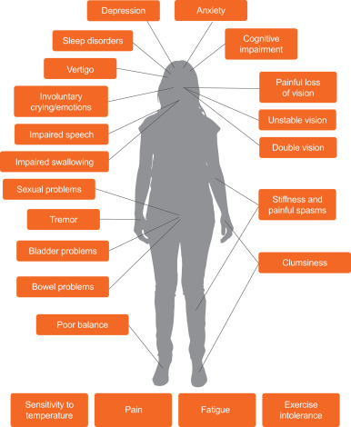
Common Challenges

Slide 39
Palliative care as a continuum in MS
At time of diagnosis
During relapse
During periods of disease progression
When MS is influenced by comorbidities
In the advanced stages of the disease
At end of life
Involves all of those touched by the disease
  Parents/spouse/children

Slide 40
What do MS Patients need Palliation of?
Pain
  Neurogenic
  Musculoskeletal
Depression/anxiety
Cognitive impairment
Spasticity
Incontinence
  Bowel
  Bladder
Constipation
Sexual health
Restricted mobility
Tremor
Fatigue
Visual loss
Impaired communication
Nutritional compromise
Bulbar (swallowing) problems
Social isolation
Personal and financial loss
  Employment
  Relationships

Slide 41
Perceptual barriers
Therapeutic nihilism/despair
“....most patients end up in wheelchairs”
“....everybody just gets worse”
“....there’s nothing more we/I can do”
“....I don’t know anything about MS”
“....I/we don’t have/see many patients with MS”
“....their waiting lists are very long”

Slide 42
Key messages
There is always something (more) that can be done
If you can’t help then there is someone else who can (or knows someone who can)

Slide 43
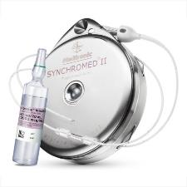
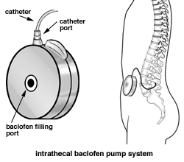

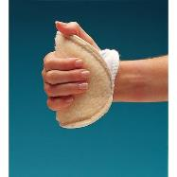
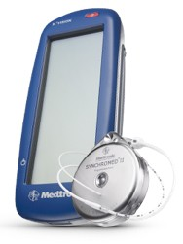
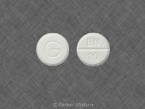
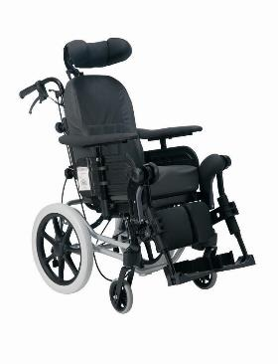
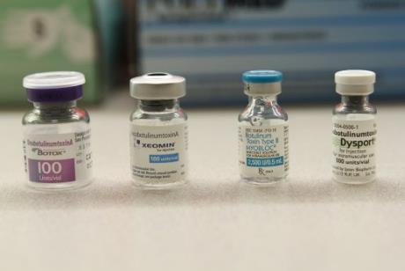
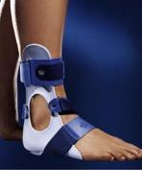
Spasticity

Slide 44
Organisational barriers
“you can only access that team if you need more than 1 member of the team”
“you don’t meet our criteria”
“you’re not over/under 65”
“we don’t go into nursing homes”
“our psychology/psychiatry service isn’t for people with neurological disorders/MS/anything disabling (delete as appropriate)”
“we don’t have a budget for splints”
  Or the more generalisable “we aren’t funded for that”
“we can make splints but only for patients with stroke/acquired brain injury/sports injuries (delete as appropriate)”
“patients in nursing homes don’t need their own wheelchairs”
“I don’t do that, I’m a Neurologist”
And the waiting lists really are awful

Slide 45
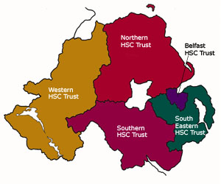
HealthCare Trusts in N. Ireland
1 resident neurologist
2 visiting (both MSSIG) neurologists
0 MS Nurses
3 resident Neurologists
2 visiting Neurologists
(incl 1 MSSIG Neurologist)
1.6 MS Nurses
10 resident Neurologists
Incl 3 MSSIG Neurologists
6.1 MS Nurses
3 resident Neurologists
Incl 1 MSSIG Neurologist
2 MS Nurses
3 resident Neurologists (incl 1 MSSIG but w/o MS Clinic)
1 visiting Neurologist
2 MS Nurses

Slide 46
Neurology Unit MPH
23 bedded facility
  9 neuropalliative care beds
    Range of neurological disorders
    MS, MND, familial young onset dementia
  2-3 rehabilitation beds
    MS patients most prevalent group
  11-12 respite care beds
    Full range of neurological disorders
    MS and Parkinsonian disorders commonest groups
400-425 admissions/yr
Opened/relocated March 2012
Part-funded by charitable donation
  £1 million from MITRE

Slide 47
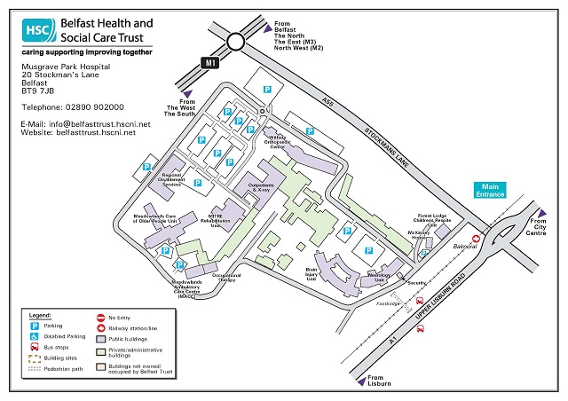

Slide 48

Hospital & Community

Slide 49
MDT approach
Physio
Speech & language therapy
Social work
Nursing staff
Activity therapist
Cleaners
Kitchen staff
Chaplains
GPs
Neurologist
OT
Dietetics
Respite co-ordinator
Secretary
Liaison neuropsychiatrist
Liaison dentistry
Counsellor
Arts therapist
Complementary therapist
Music therapist

Slide 50

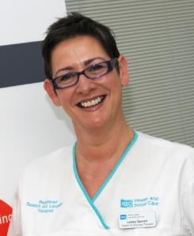
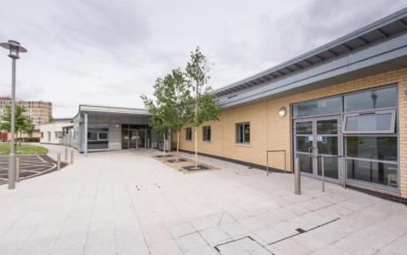
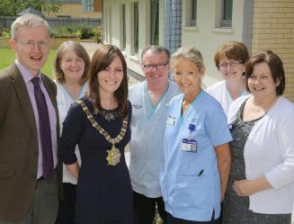
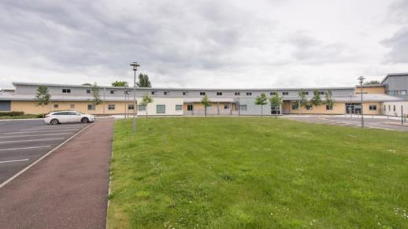

Slide 52
Services
MDT meetings weekly
Family meetings
Joint meetings with community teams
Joint PT/OT Therapy room
Assessment/sensory room
Quiet room
S&LT room
Day/dining room
Garden
Outpatient area
  Spasticity Clinic
  Activities
Site services
Regional Wheelchair Service
Regional Communication Advice Centre
Orthotics Clinics
Imaging services
MITRE gym
Therapy facilities in RABIU
Meeting facilities in RABIU

Slide 53
But we don’t have.......
Enough capacity/beds to help all who need it
Enough therapy staff
Enough medical input
Neuropsychology support
Specialist palliative care input
  There is no palliative care provision on the Musgrave Park site

Slide 54
Case study 1
NH
40yo female
Aggressive relapsing-remitting course & rapid transition to secondary progressive phase
Living with daughters
Challenging domestic situation – difficult adherence to professional advice re: care/safety
Frequent acute hospital admissions, aspiration, skin care issues
Respite offered initially
Best interests – offer and acceptance of neuropalliative bed
PEG feeding
Ultimately mini-tracheostomy to facilitate secretions
Full nursing care
Gradually progressive course
Discussions re: ceilings of care
Acute hospital transfers avoided
Daughter’s wedding pending
  Family meeting, discussion re; potentially precarious nature of mother’s health
Wedding brought forward by several months
Facilitated on MPH site in Hospital Chapel, NH in attendance
Family/wedding photos in Unit
NH passed away few weeks later

Slide 55
Case study 2
BN
60 yo male
Secondary progressive MS
Living with wife, struggling at home – danger of relationship breakdown
Tensions due to bowel management problems
Difficulties with personal care and transfers due to spasms and spasticity
Began accessing respite at MPH
Spasticity managed with an intrathecal baclofen (ITB) pump
Bowels managed with a colostomy
Stress levels falling, relationship intact
Managing at home

Slide 56
Case study 3
MB
55yo female
Longstanding SPMS patient
Accessed respite care for couple of years
  Support for elderly parents who were also caring for MB’s brother (autism and MS)
Regular acute hospital admissions, critically ill
Nutritional deficits
Home care no longer realistic
Transitioned to neuropalliative bed
Complex needs – spastic quadriparesis, PEG feeding, limited communication, single functioning kidney, recurrent chest and urine infections, relatively retained cognition
Values life, family interactions
Acute hospital admissions avoided
Weekly visits home despite disability level
Key member of her family circle

Slide 57
Respite role in Palliative care
Physical & emotional benefits for patients
Review of symptom management
  These are mainly progressive disorders
Review of care arrangements
Support at times of crisis
Physical and emotional benefits for carers/families
  Many have healthcare issues of their own
Families better able to return to caring roles
Helps to keep families together and at home

Slide 58
Summary
Palliative management is fundamental to effective MS care (& it doesn’t stop with patients)
Access to comprehensive care for MS patients remains an aspiration - provision is patchy
Current H&SC provision across 5 Trusts is unhelpful & facilitates postcode lottery
Advances in disease modifying therapy for MS welcome but important not to lose sight of symptom management and multidisciplinary care
There is no formal collaboration (yet) between Neurology and Specialist Palliative Care – we need to embed and integrate
Palliative care resources have to be multidisciplinary and should be patient-centred and problem orientated rather than service-centred
There is a need to address the palliative needs of MS patients in nursing homes – real risk (?reality) that these patients are forgotten and neglected

Slide 59
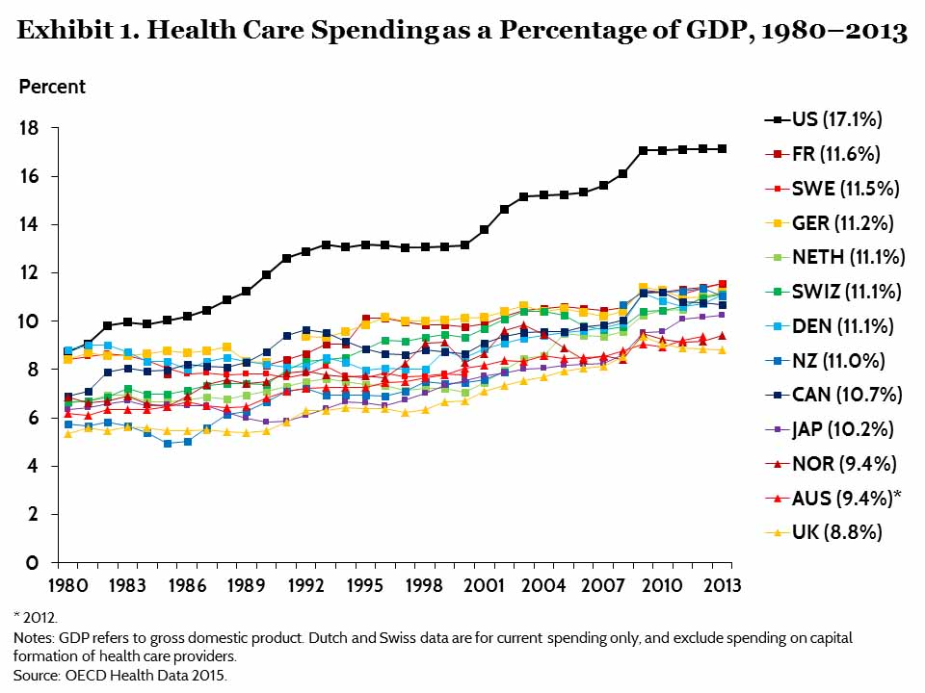

Slide 60
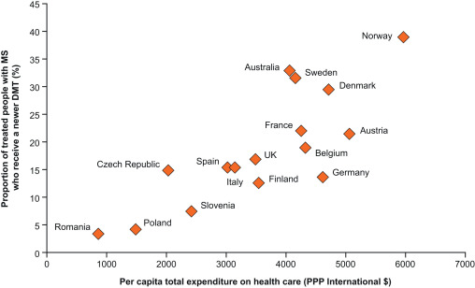
Is access to DMTs related to overall healthcare spending?

Slide 61
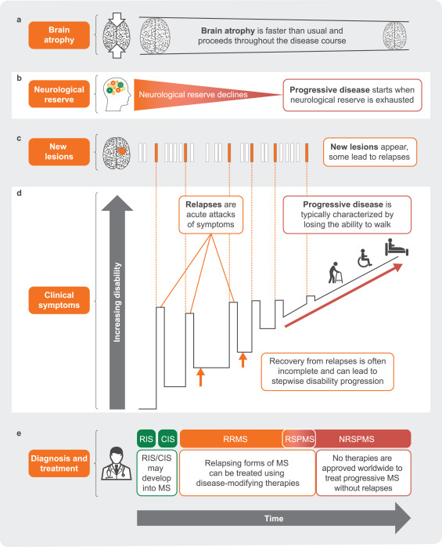

Slide 62
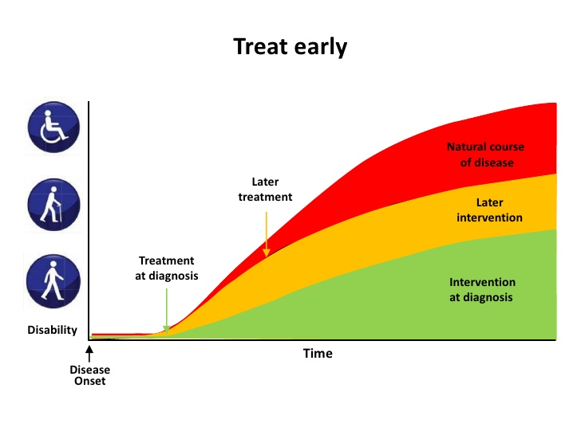

Slide 63
Joan McEwan
Head of Policy and Public Affairs
Marie Curie Northern Ireland
#MSPallCare

Slide 64

Perceptions of Palliative Care
Associated with end of life
Association with cancer
Incompatible with active treatment
“Hospice is actually terrifying… linked for me with being absolutely helpless, the last step, and actually just vegetating… Keep it at a distance. Best not to experience this.”
MS patient
“Palliative care for persons suffering from MS is perhaps a relatively wild idea… different from, for example, cancer patients, where one more likely intuitively believes that also palliative care might make sense, [it] is rather unusual for those suffering from MS.”
Neurologist
Golla, H et al (2014). Multiple sclerosis and palliative care – perceptions of severely affected multiple sclerosis patients and their health professionals: a qualitative study. BMC Palliative Care, 13 (1).

Slide 65
Uncertain disease trajectory
Long trajectory
Prognosis accuracy 23-78%
“Recognising the dying phase was noted by staff as a particular challenge in their care of people with long-term neurological conditions. Staff commented on the unpredictability of the disease trajectories, noting that these varied among individuals with the same disease.”
Wilson, E et al (2011). Perspectives of staff providing care at the end of life for people with progressive long-term neurological conditions. Palliative and Supportive Care, 9 (4).

Slide 66
Communication
Between healthcare professionals
Advance care planning
Pain management

Slide 67
Solutions
Awareness of palliative care and its benefits
Identify triggers and referral
Communication across MDTs and health professions
Advance care planning

Slide 68

Palliative Care in Partnership Programme
Priorities
Identification
Keyworker
Advance Care Planning
Specialist Palliative Care Services
Good practice tools and guidance

Slide 69
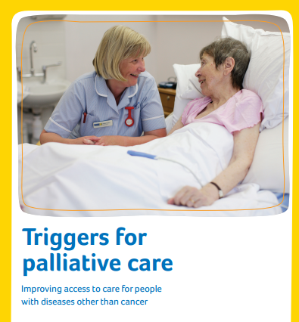
Widening the reach of palliative care
Older population + comorbidities = greater demand for PC now and in the future
Everyone has a role to play in improving access

